Slide 1

European cultural heritage on stage
Greece - Macedonia – Serbia – Bulgaria | July 2018 – June 2019

Slide 2
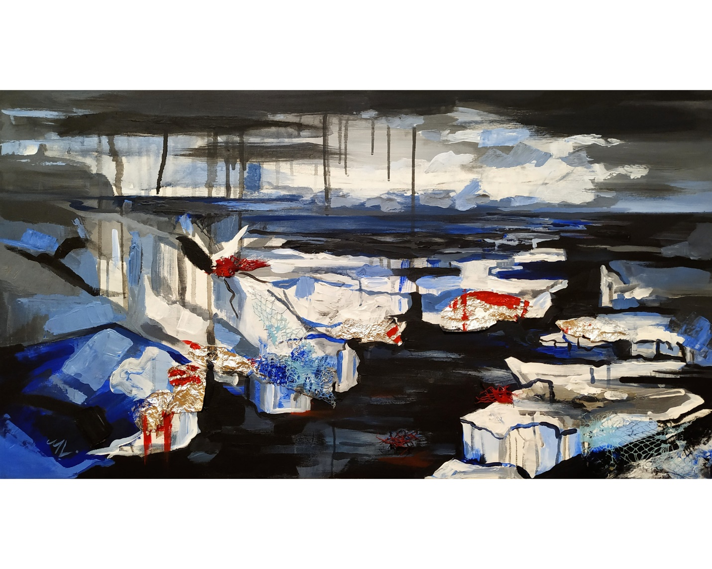
MARTINA LAPICA (Bulgaria)
“On Danube I”,
acrylic and collage, canvas 55x100 cm

Slide 3
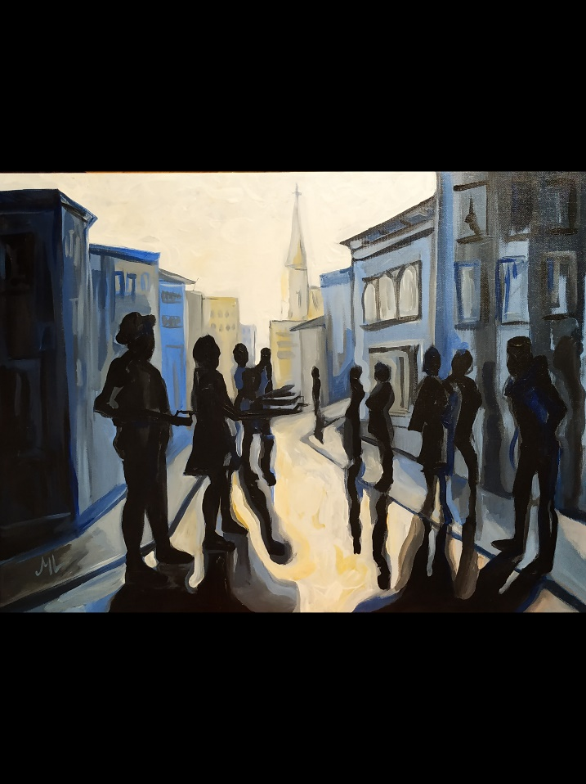
MARTINA LAPICA (Bulgaria)
“Morning…”,
acrylic, canvas (55x40 cm)

Slide 4
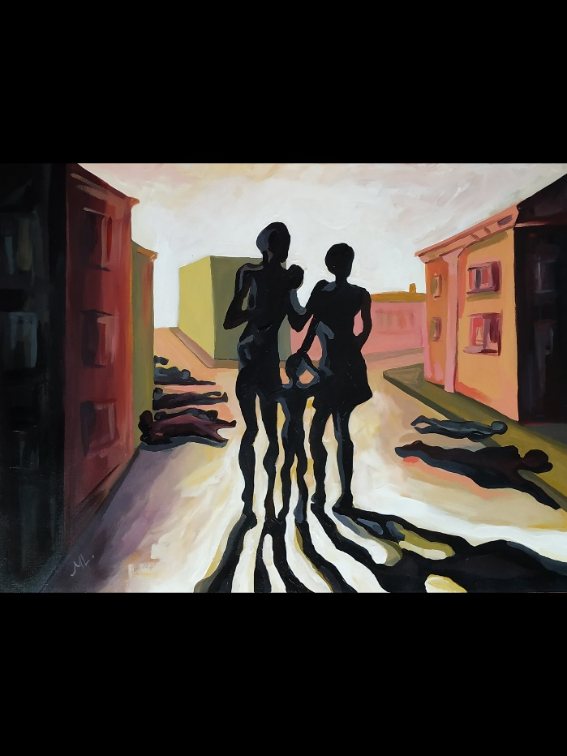
MARTINA LAPICA (Bulgaria)
“…Afternoon.”,
acrylic, canvas (55x40 cm)

Slide 5
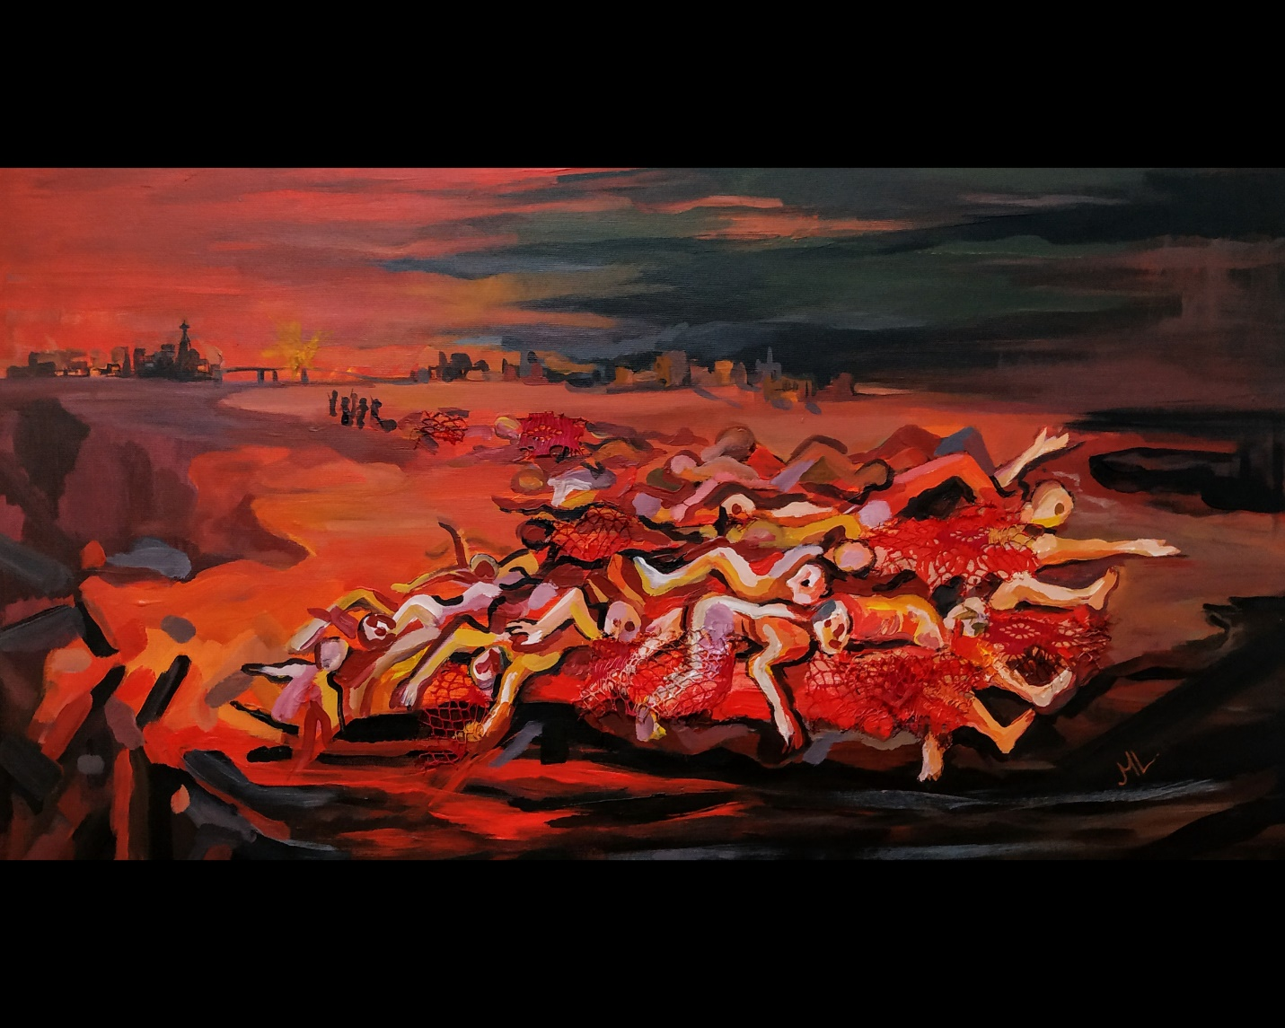
MARTINA LAPICA (Bulgaria)
“On Danube II”,
acrylic, canvas 55x100 cm

Slide 6
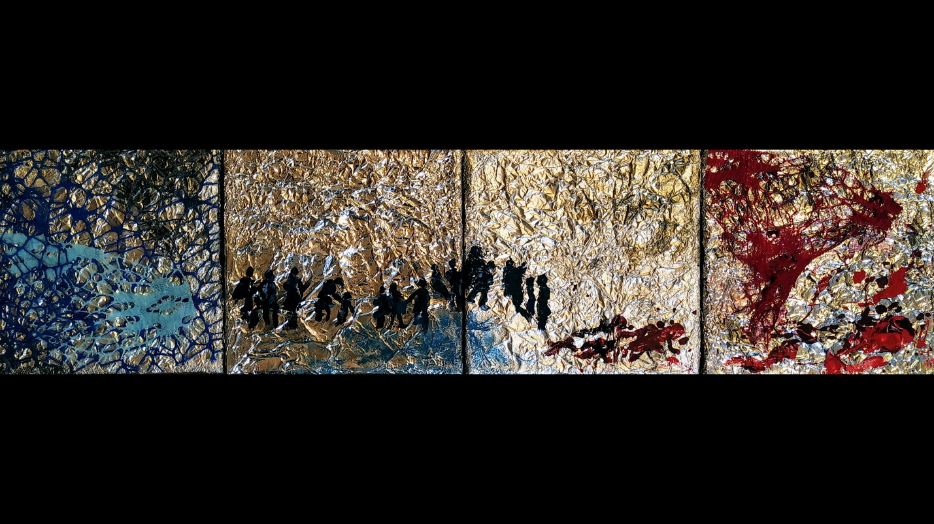
MARTINA LAPICA (Bulgaria)
“Winter 1942”,
mixed technique

Slide 7
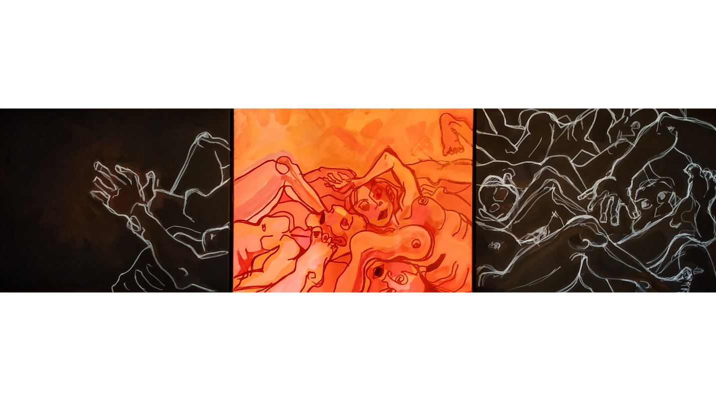
MARTINA LAPICA (Bulgaria)
"From footage" I tripped,
technique: acrylic and markers.

Slide 8
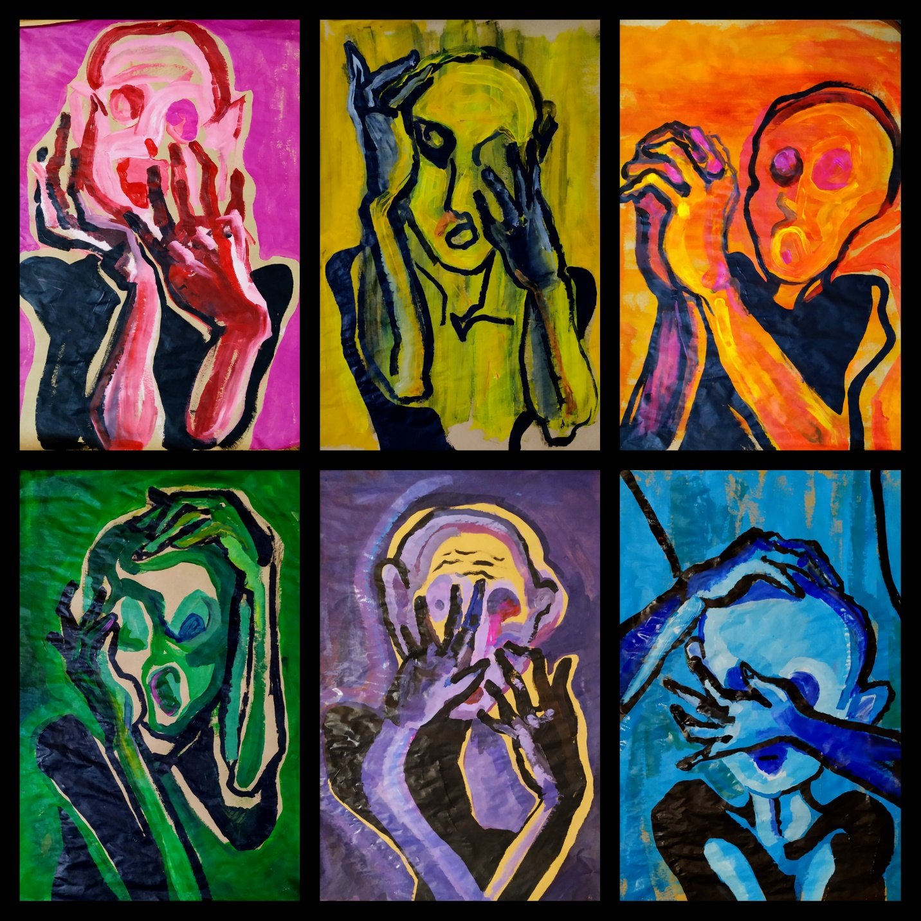
MARTINA LAPICA (Bulgaria)
“Horrors”, composition of 6 pieces,
paper 50x70cm, acrylic.

Slide 9
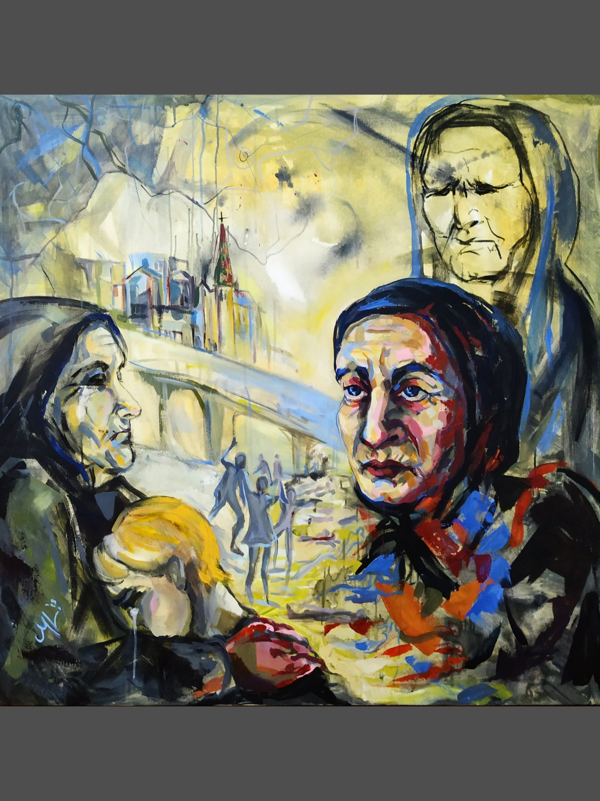
MARTINA LAPICA (Bulgaria)
“Private”, acrylic,
canvas 100x100 cm

Slide 10
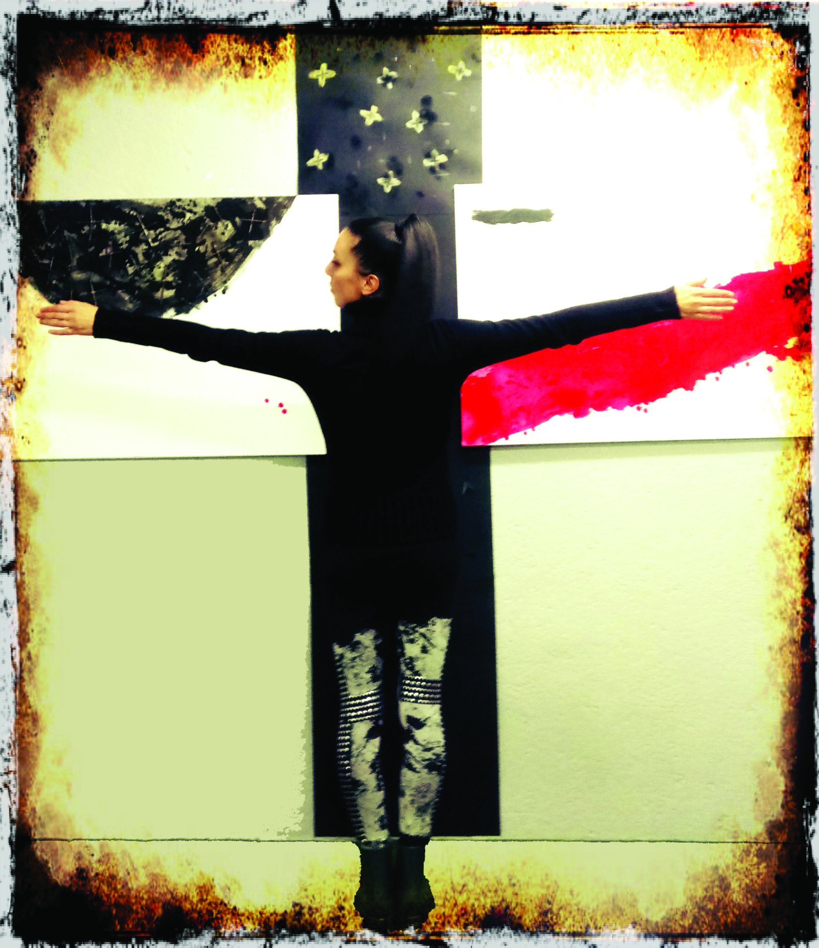
Ivanka stavreva (Bulgaria)
“Road”, paper 100x70 cm, acrylic
They are heading towards death.
And they are singing. It’s nice.
You go here, you go there and you drag this grief after you ,
and you furrow the earth and the others
stumble into it and can not walk normally.

Slide 11
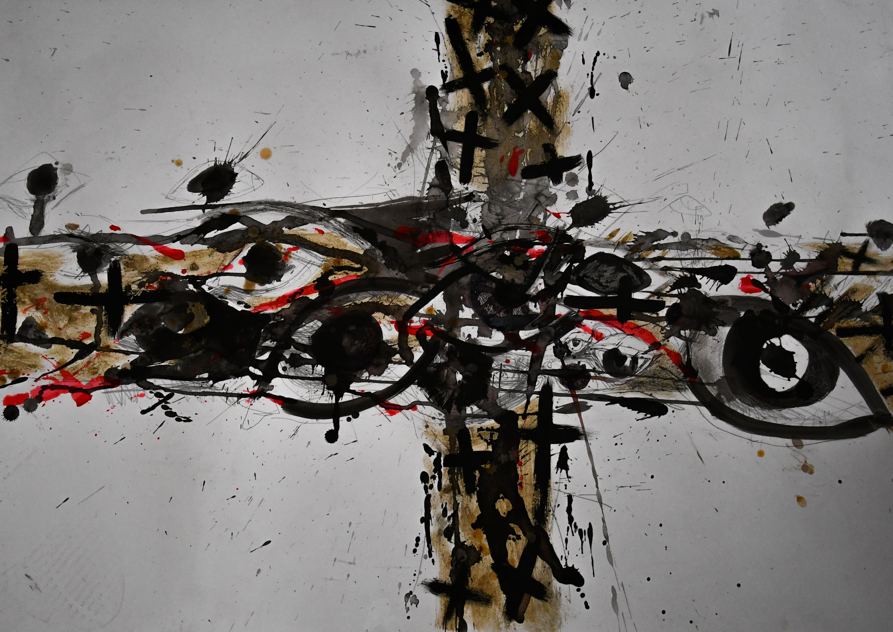
Ivanka stavreva (Bulgaria)
“Cross by the cross... Endlessly”, paper 50x70 cm, tape, burns
Eight. Endless. Crosses

Slide 12
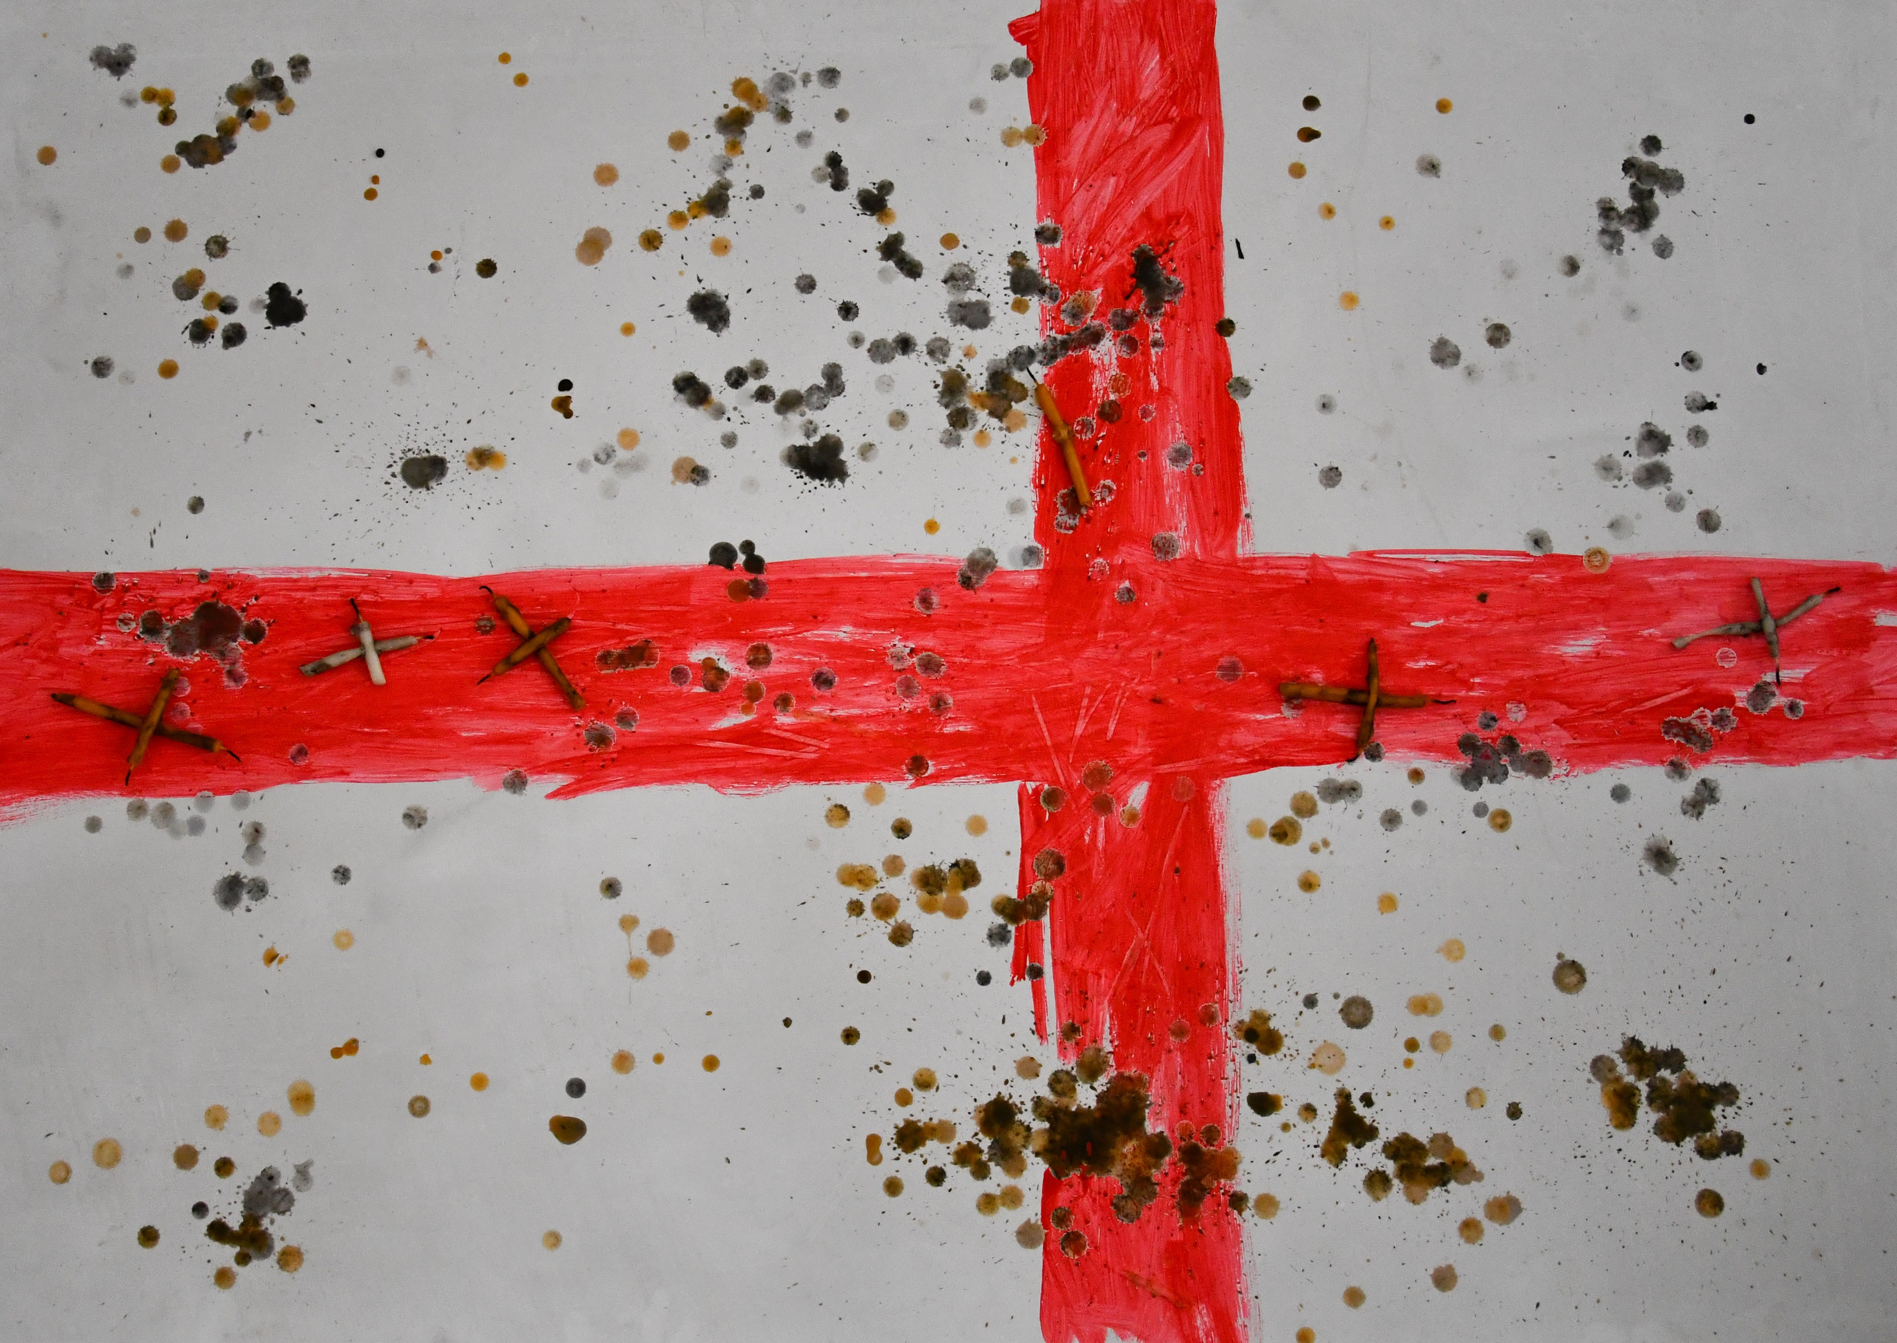
Ivanka stavreva (Bulgaria)
“Cross. As an end…”, paper 100x70 см, acrylic, wax
A drop of blood gently torn from the doomed sky. Her lips are beautiful
in red. It was worth is for his heart to die.

Slide 13
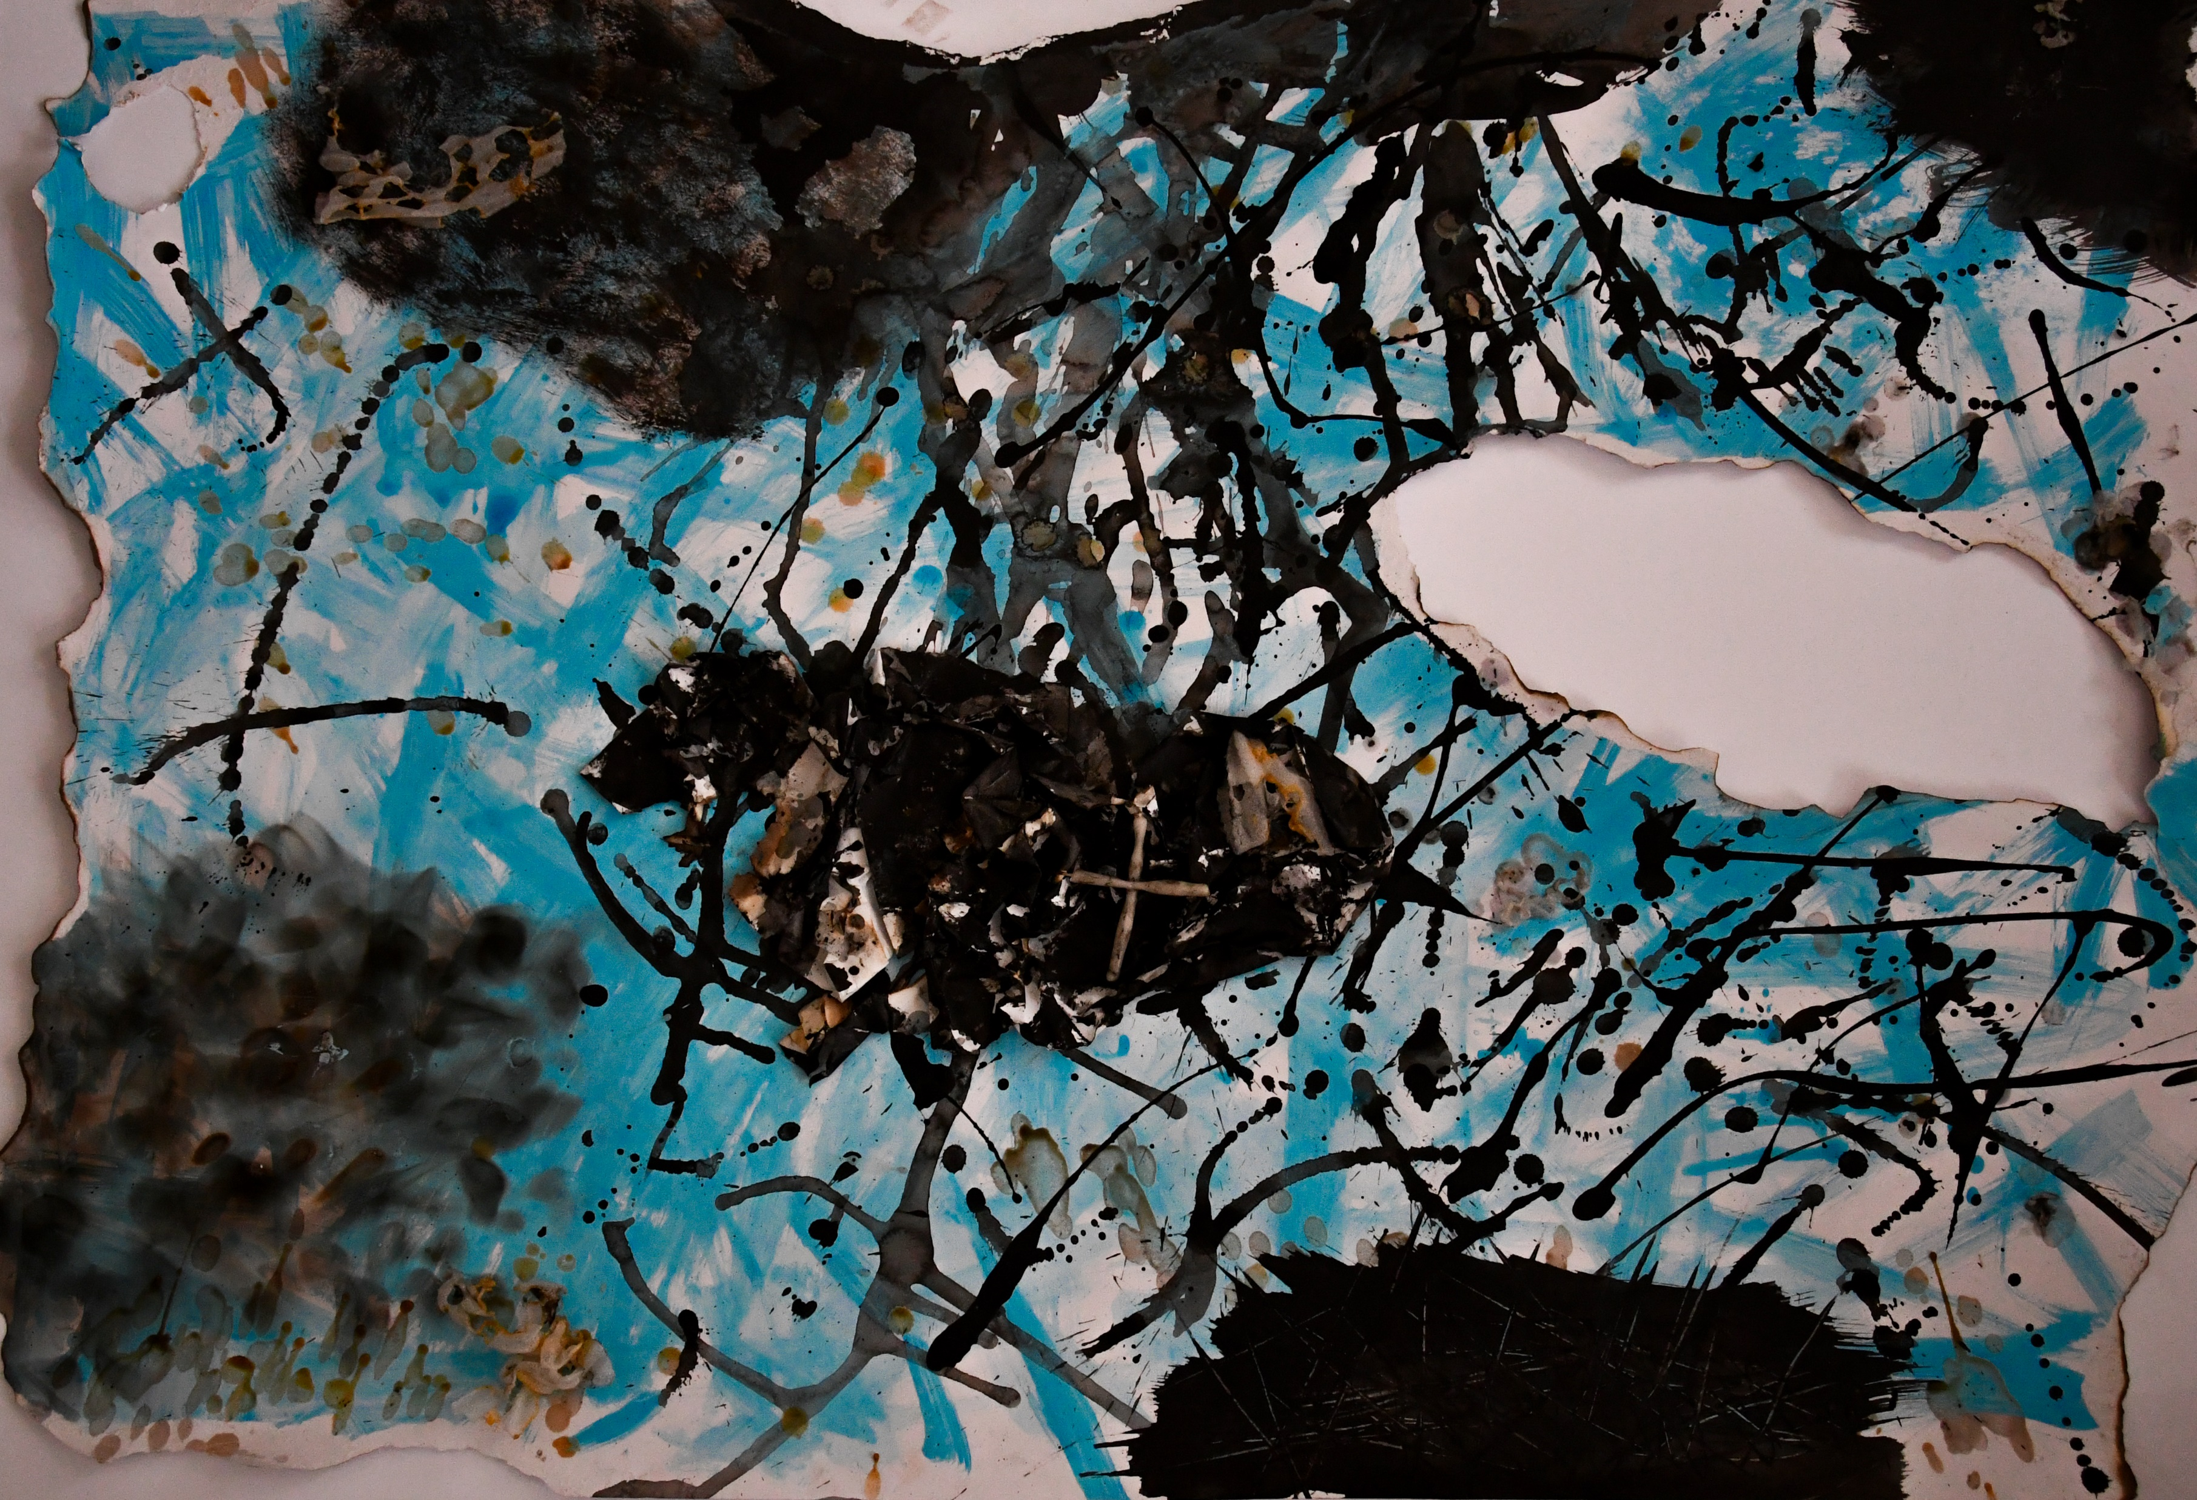
Ivanka stavreva (Bulgaria)
“Someone stole the sky... their sky”, paper 100x70 cm, collage, burning, gluing, wax, acrylic
Someone tore the sky…their sky.
Someone insulted them.

Slide 14
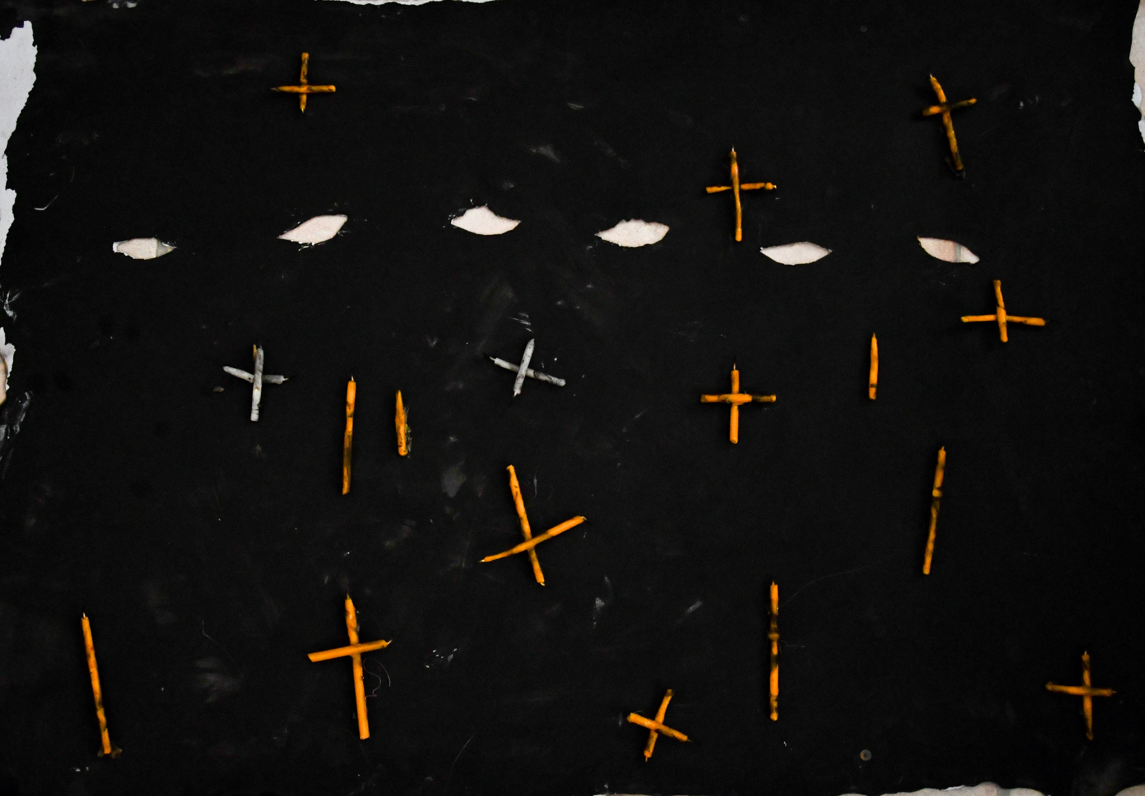
Ivanka stavreva (Bulgaria)
“Eye to eye with war”, paper 100x70 cm, acrylic, thin pencils
Cruelty
is a white beauty
with a crippled wooer.
Their daughter is one eyed,
to see only the
good war.

Slide 15
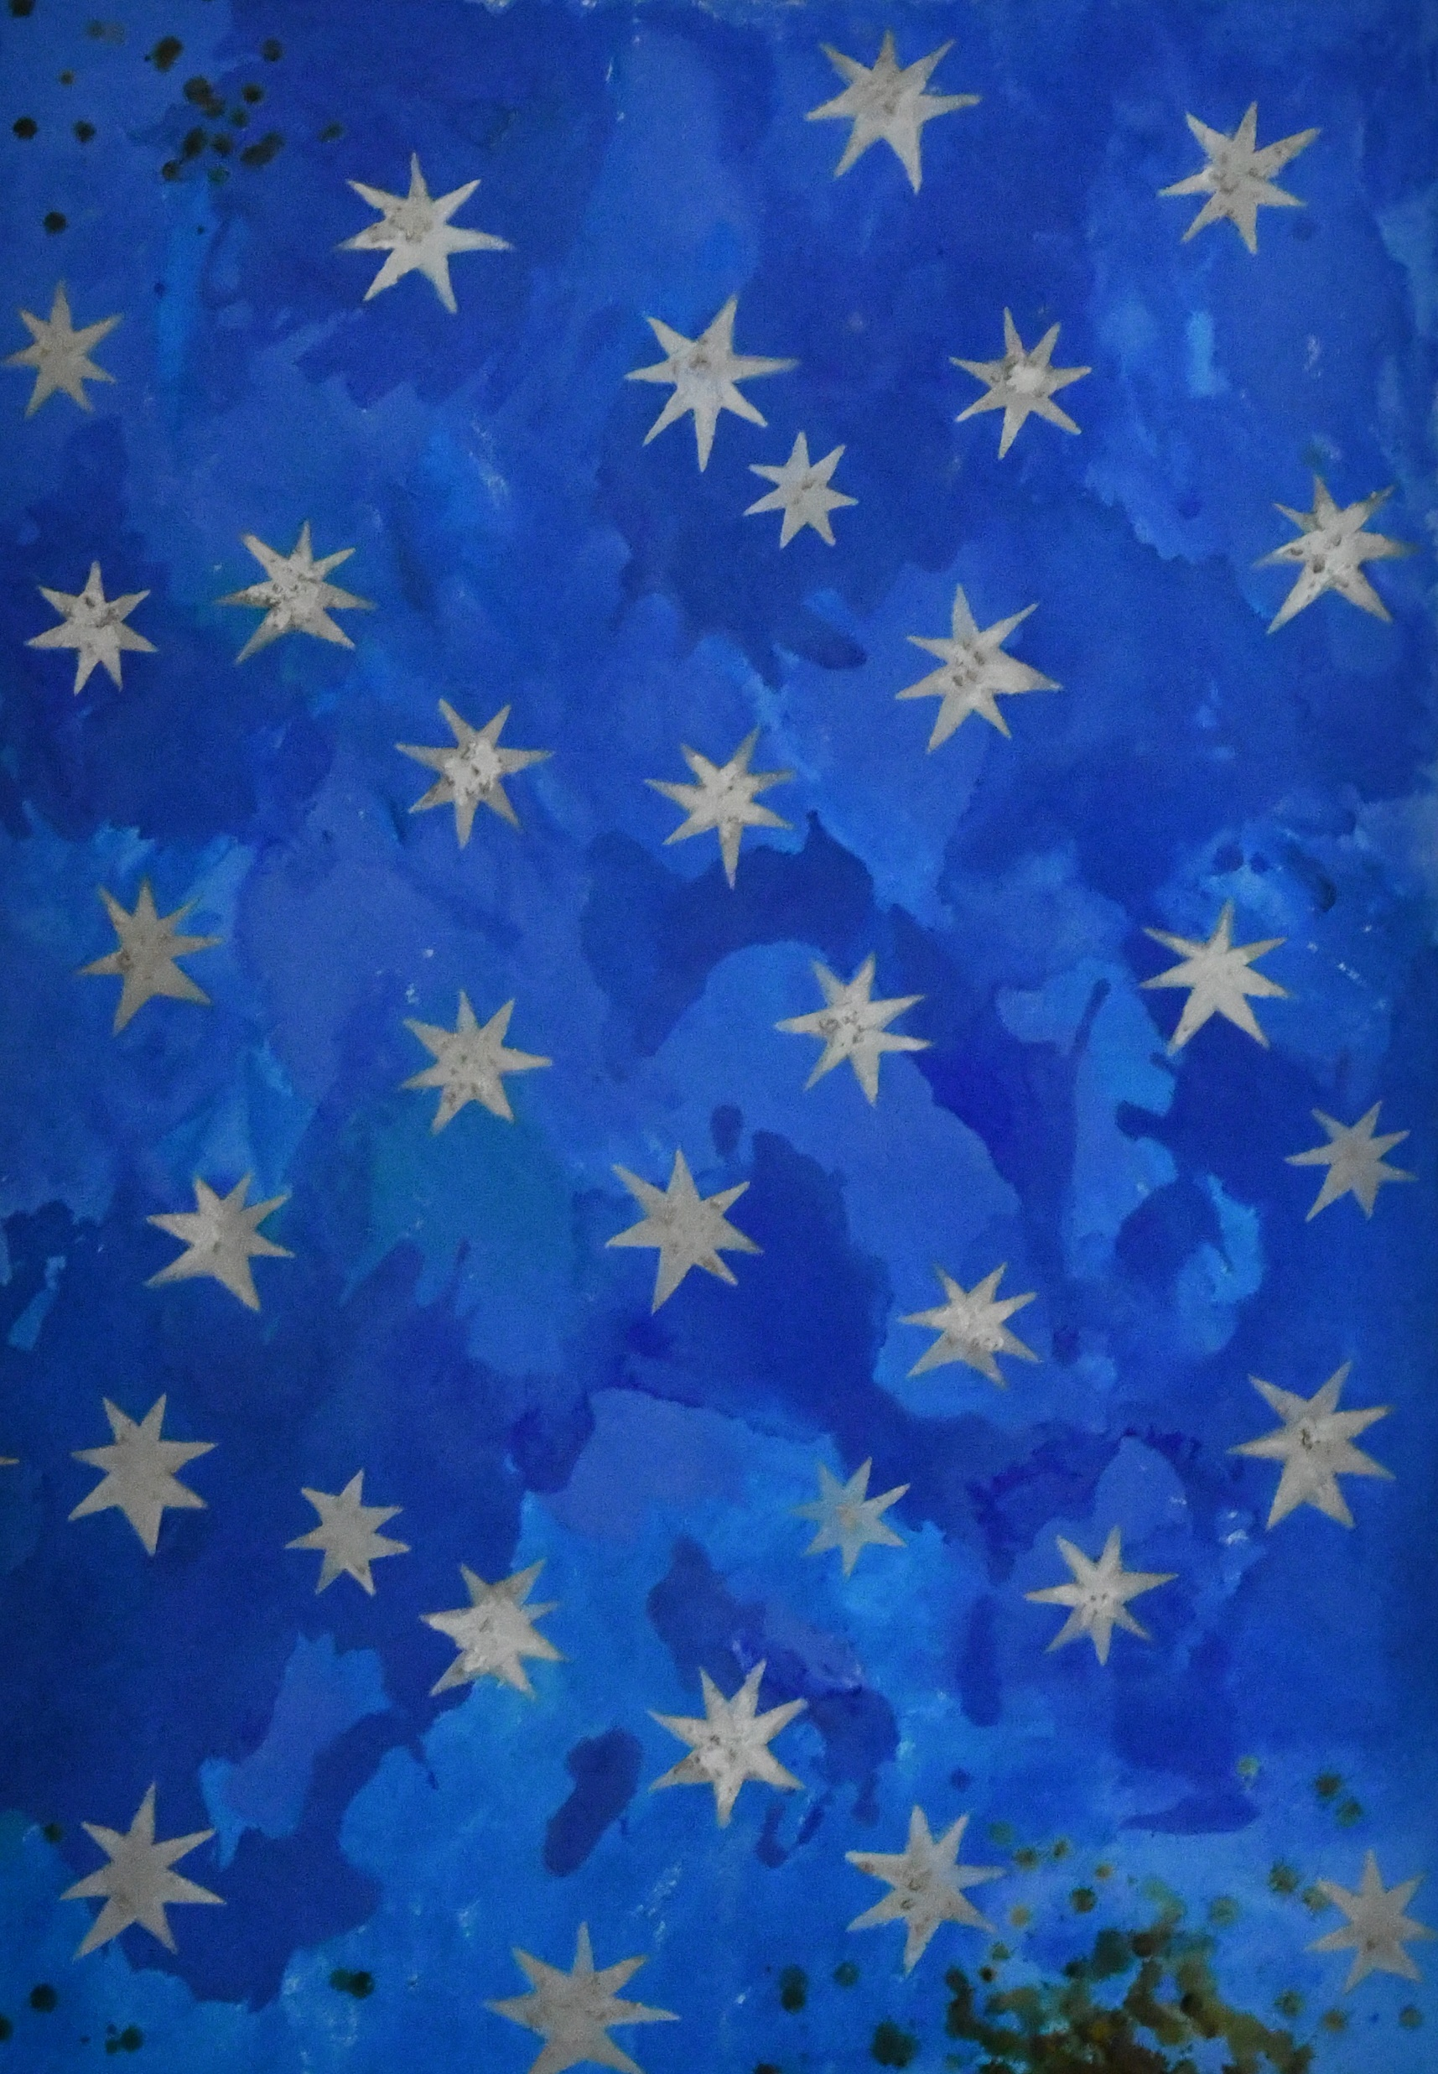
Ivanka stavreva (Bulgaria)
“On the heavens of the universe ... Stars”, canvas 100x70 cm, acrylic, soil, wax
And he scattered with His hand stars,
to decorate this eternal beauty ...

Slide 16
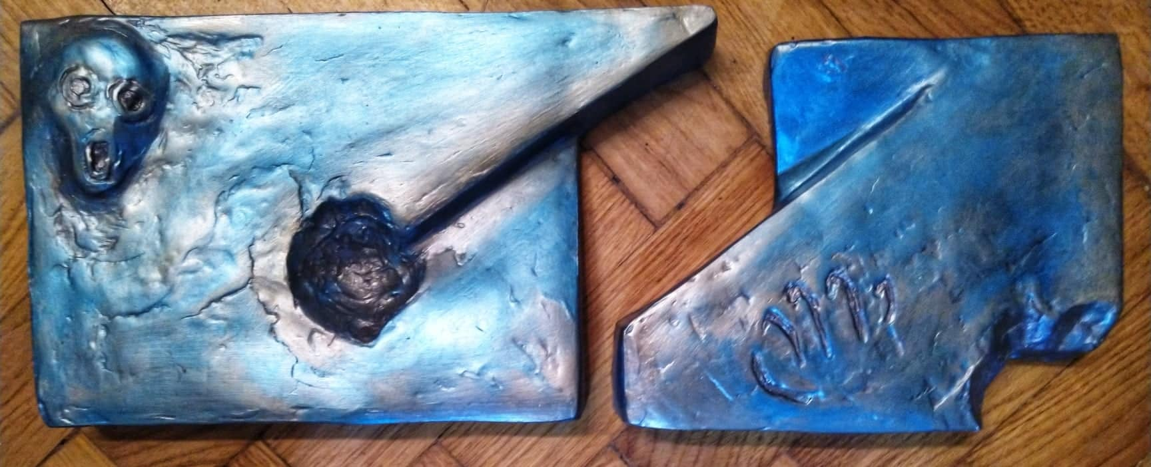
KIRIL T. KONSTANTIN
(macedonia)
Frozen Danube

Slide 17
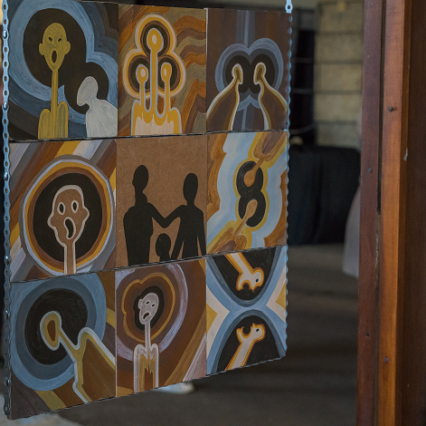
KIRIL T. KONSTANTIN
(macedonia)
Scream 1 & 2

Slide 18
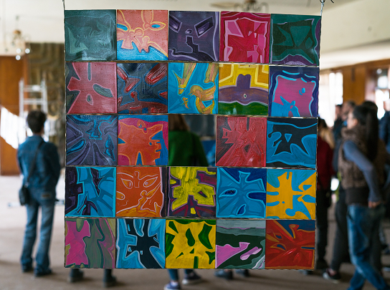
KIRIL T. KONSTANTIN
(macedonia)
Scream 3

Slide 19
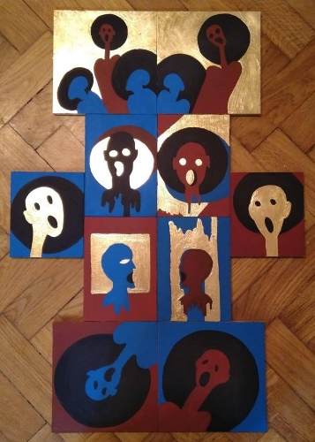
KIRIL T. KONSTANTIN
(macedonia)
Shadows

Slide 20
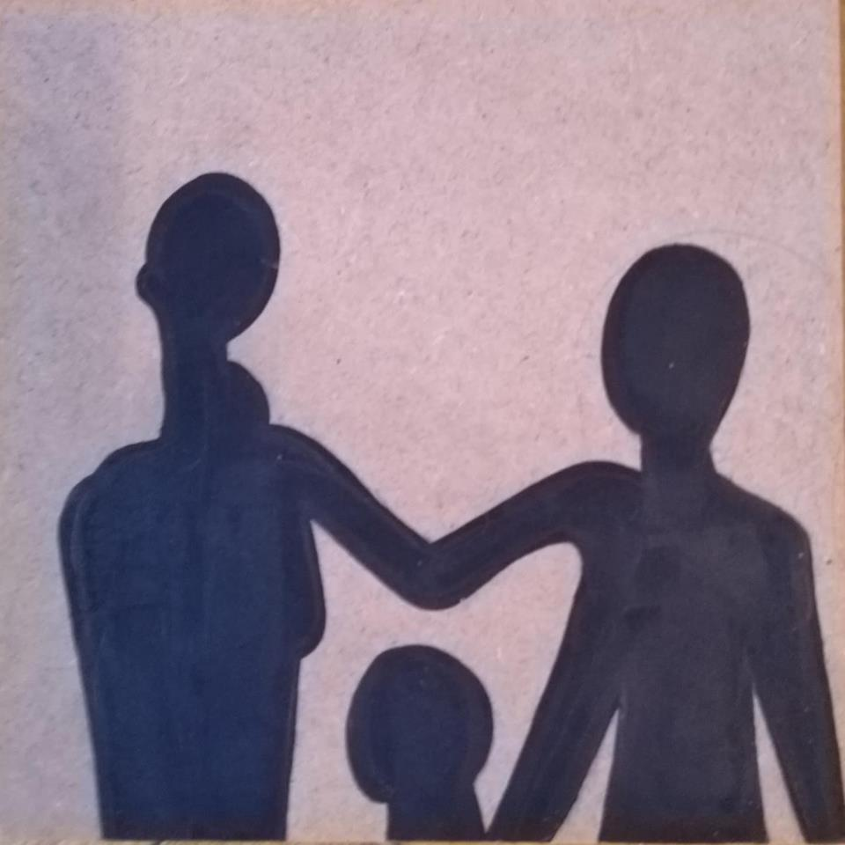
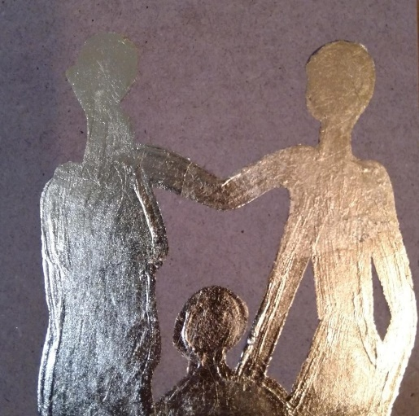
KIRIL T. KONSTANTIN
(macedonia)
Family 1 & 2
(Inspired by the Monument to the victims of the Raid in Novi Sad)

Slide 21
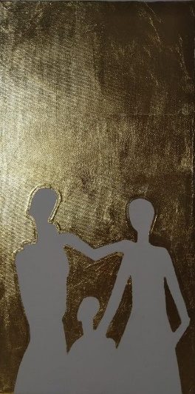
KIRIL T. KONSTANTIN
(macedonia)
Family 3
(Inspired by the Monument to the victims of the Raid in Novi Sad)

Slide 22
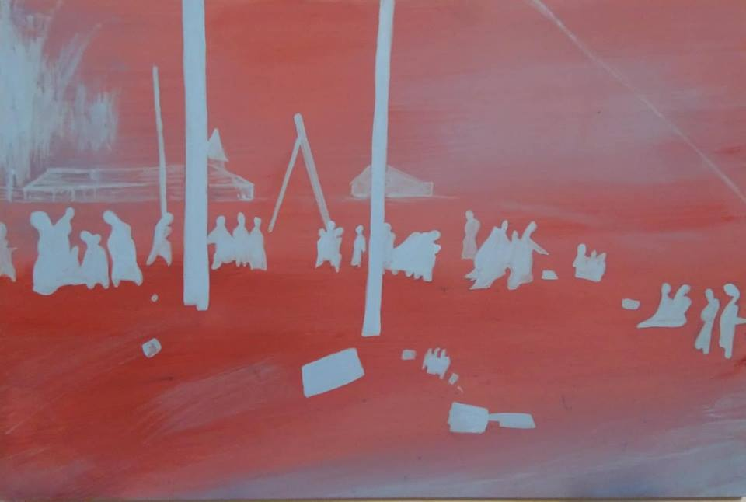
KIRIL T. KONSTANTIN
(macedonia)
Road to Danube 1
(Inspired by a photograhy of the Raid in Novi Sad)

Slide 23
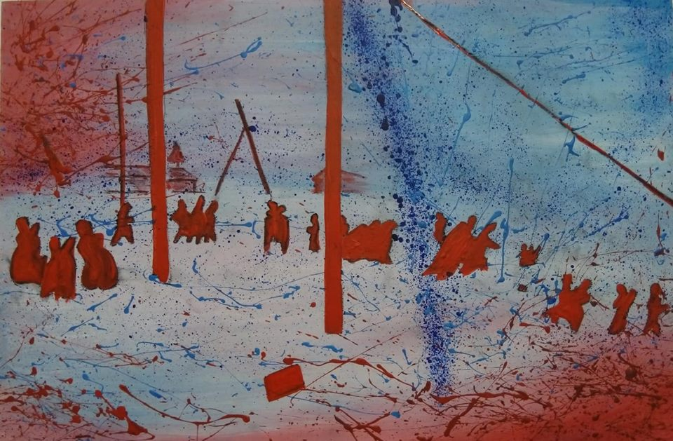
KIRIL T. KONSTANTIN
(macedonia)
Road to Danube 1I
(Inspired by a photograhy of the Raid in Novi Sad)

Slide 24
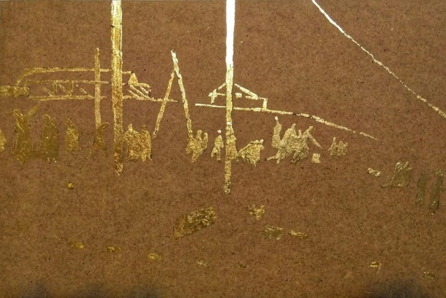
KIRIL T. KONSTANTIN
(macedonia)
Road to Danube III
(Inspired by a photograhy of the Raid in Novi Sad)

Slide 25
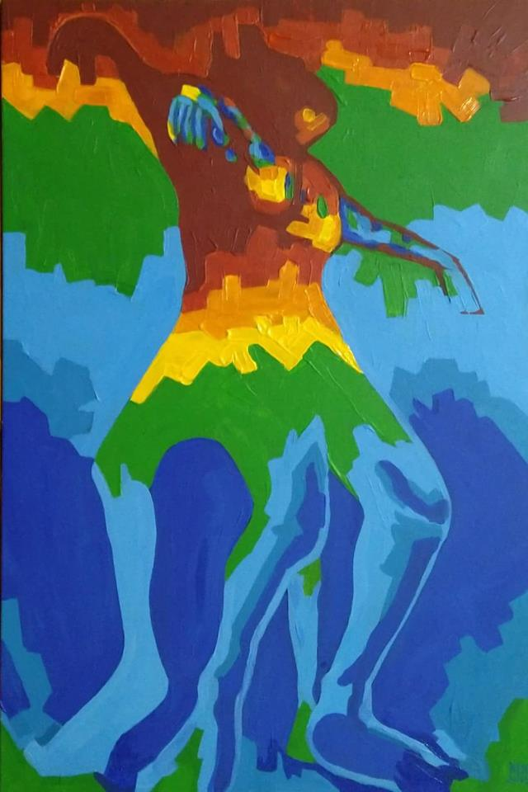
KIRIL T. KONSTANTIN
(macedonia)
5496/1
(Inspired by a photograhy of the Raid in Novi Sad)

Slide 26
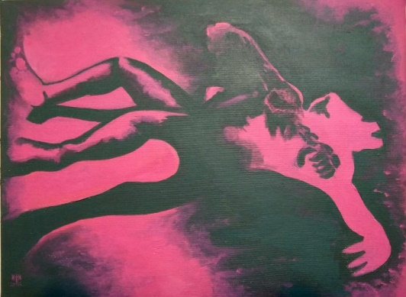
KIRIL T. KONSTANTIN
(macedonia)
5496/2
(Inspired by a photography of the Raid in Novi Sad. 5496 is the number of the photography from the archive book about the Raid in Novi Sad in WW2)

Slide 27
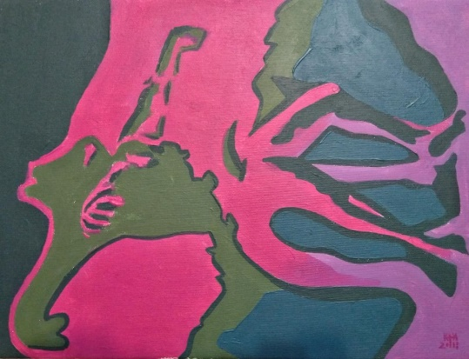
KIRIL T. KONSTANTIN
(macedonia)
5496/1
(Inspired by a photograhy of the Raid in Novi Sad. 5496 is the number of the photography from the arhive book about the Raid in Novi Sad in WW2

Slide 28
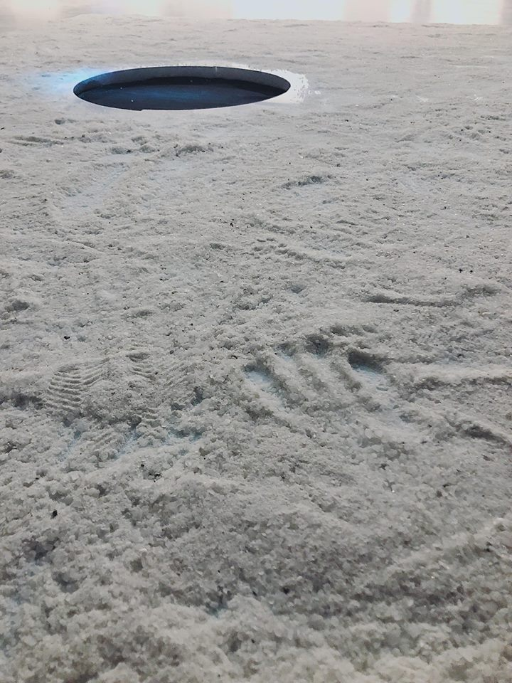
BOJAN JOSIĆ (Serbia)
Surface, installation

Slide 29
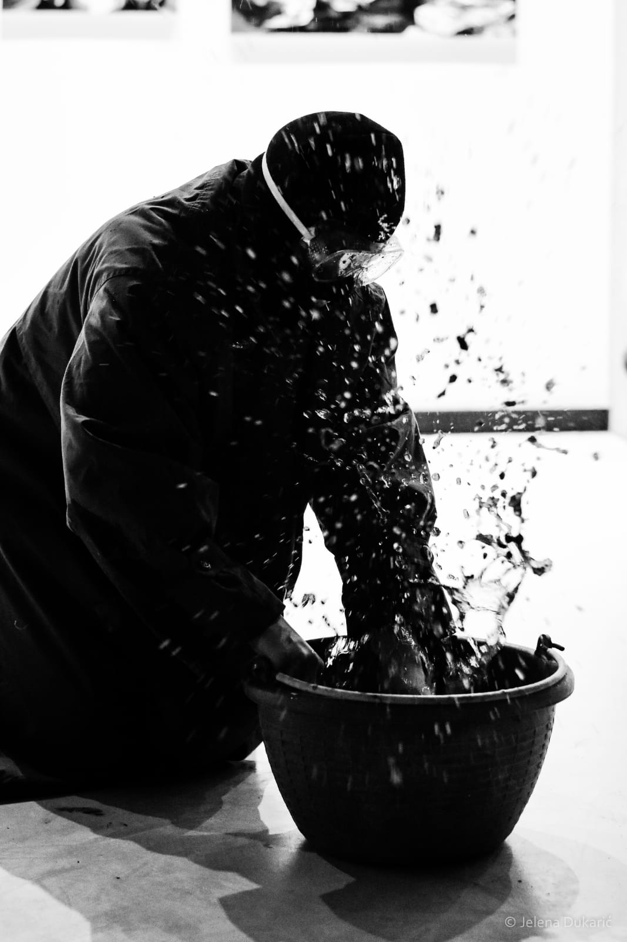
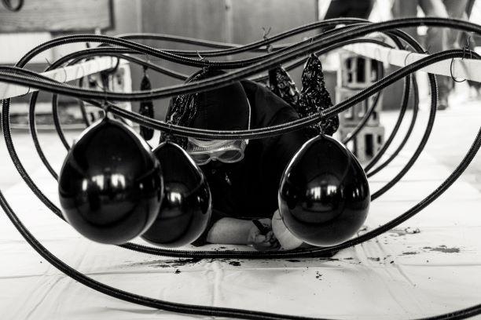
DEPY ANTONIOU
(Greece)
“Mračno nasleđe“ / Dark Heritage, installation

Slide 30
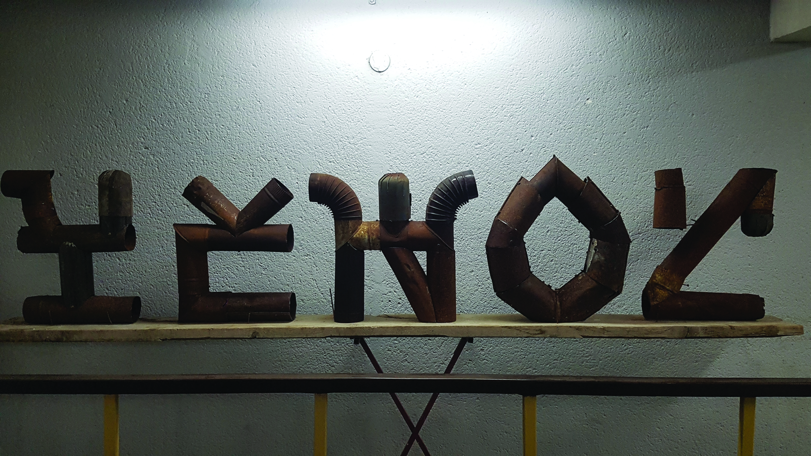
Aristaios Tsousis
(Greece)
YEHOZ, EPONYMO
50 x 70 x 15 cm X 5, metal sheets

Slide 31
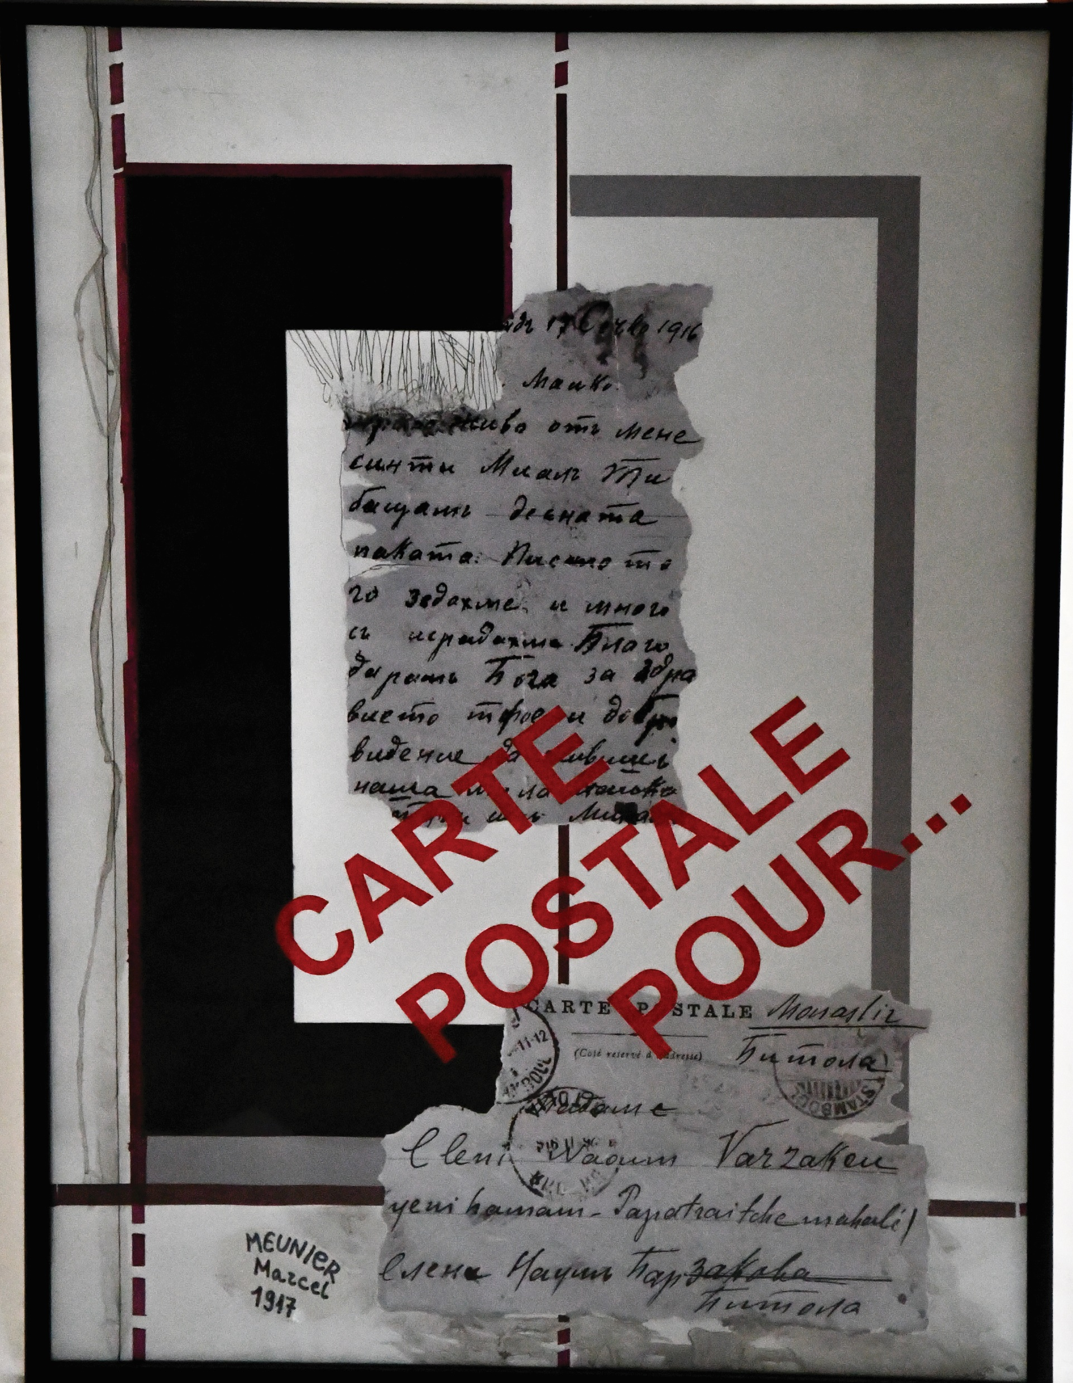
Ljubica Meshkova – Solak (Macedonia)
Carte postal Pour...,
975 mm x 635 mm paper in list

Slide 32
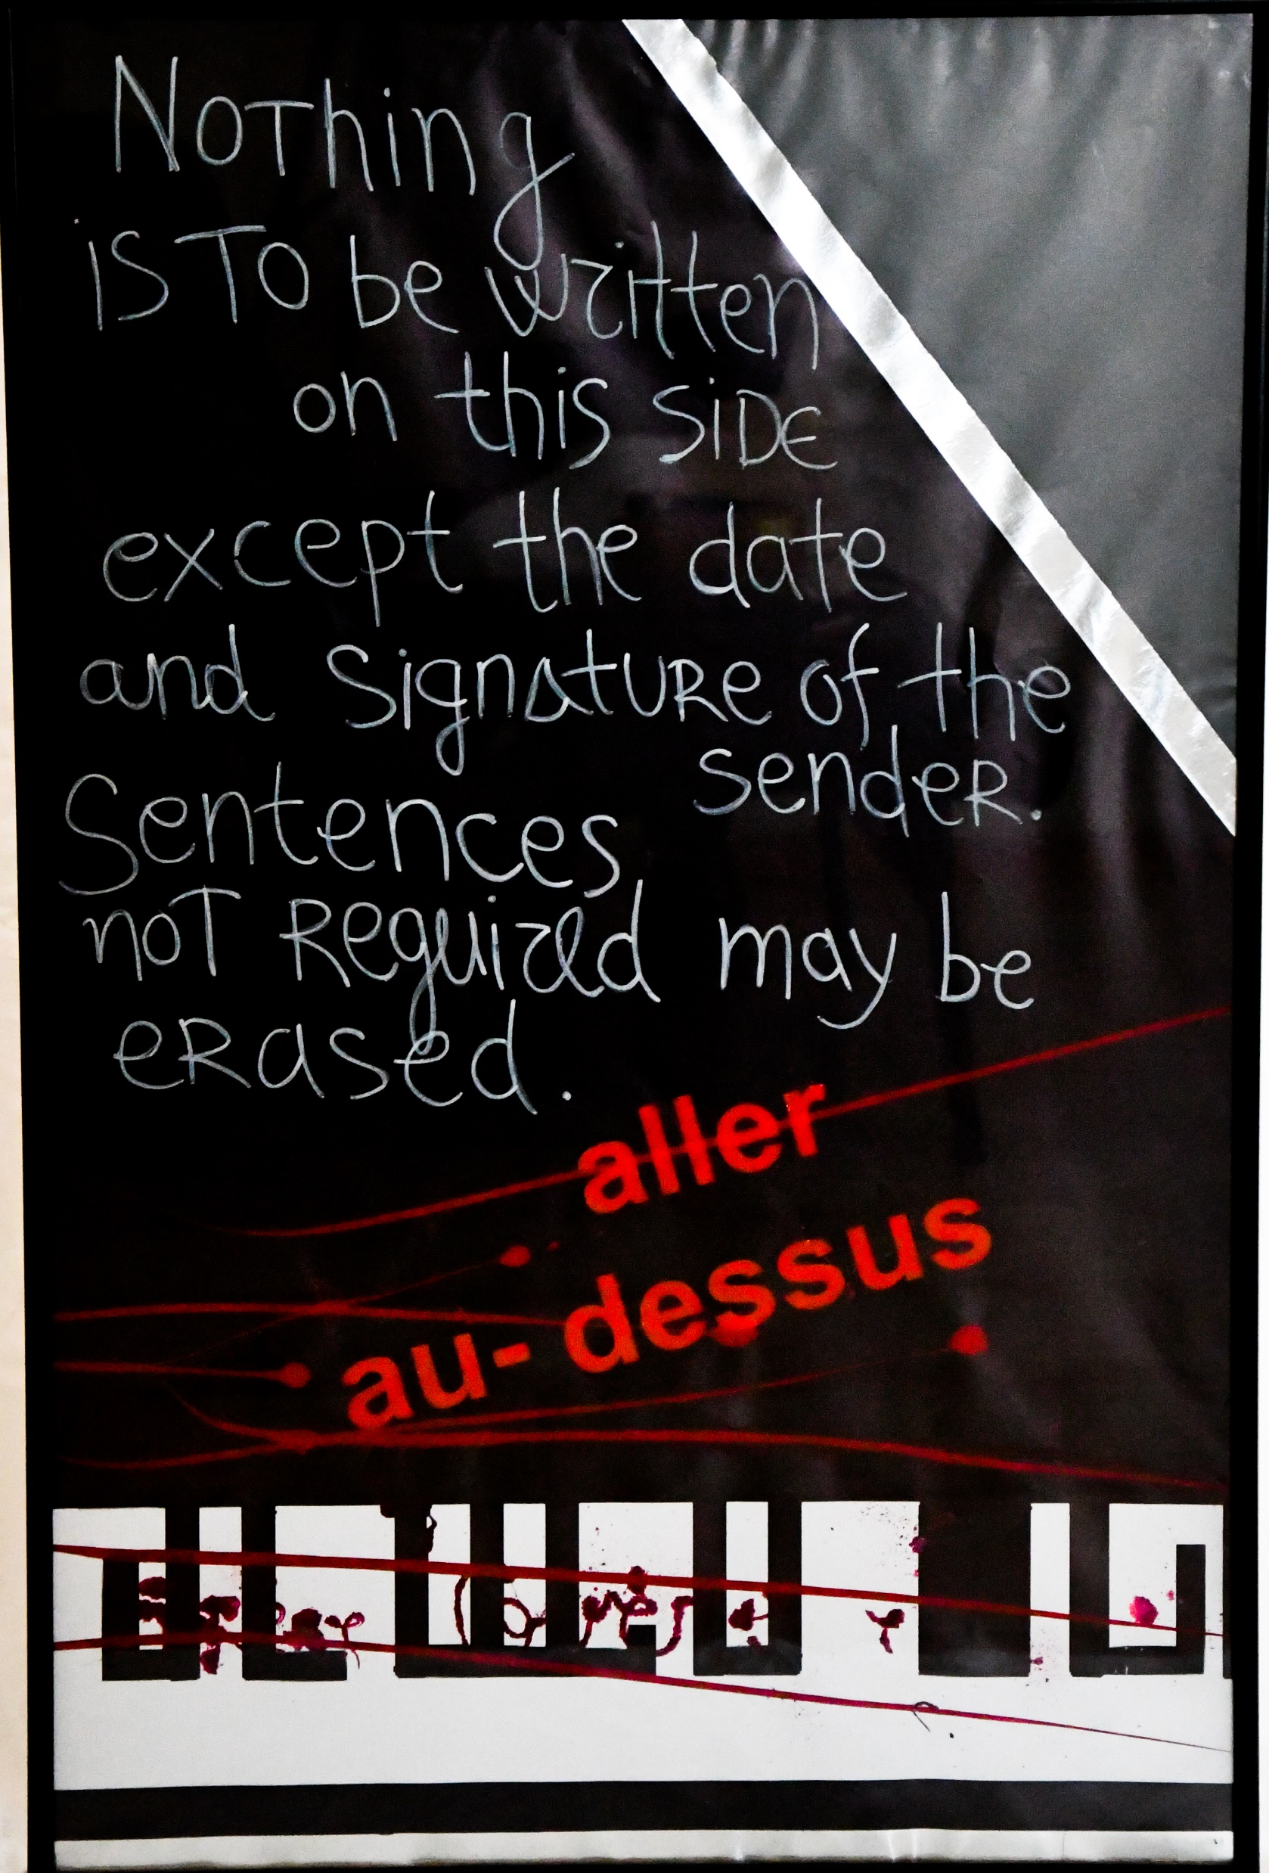
Ljubica Meshkova – Solak (Macedonia)
725 mm x 535 mm, paper in list

Slide 33
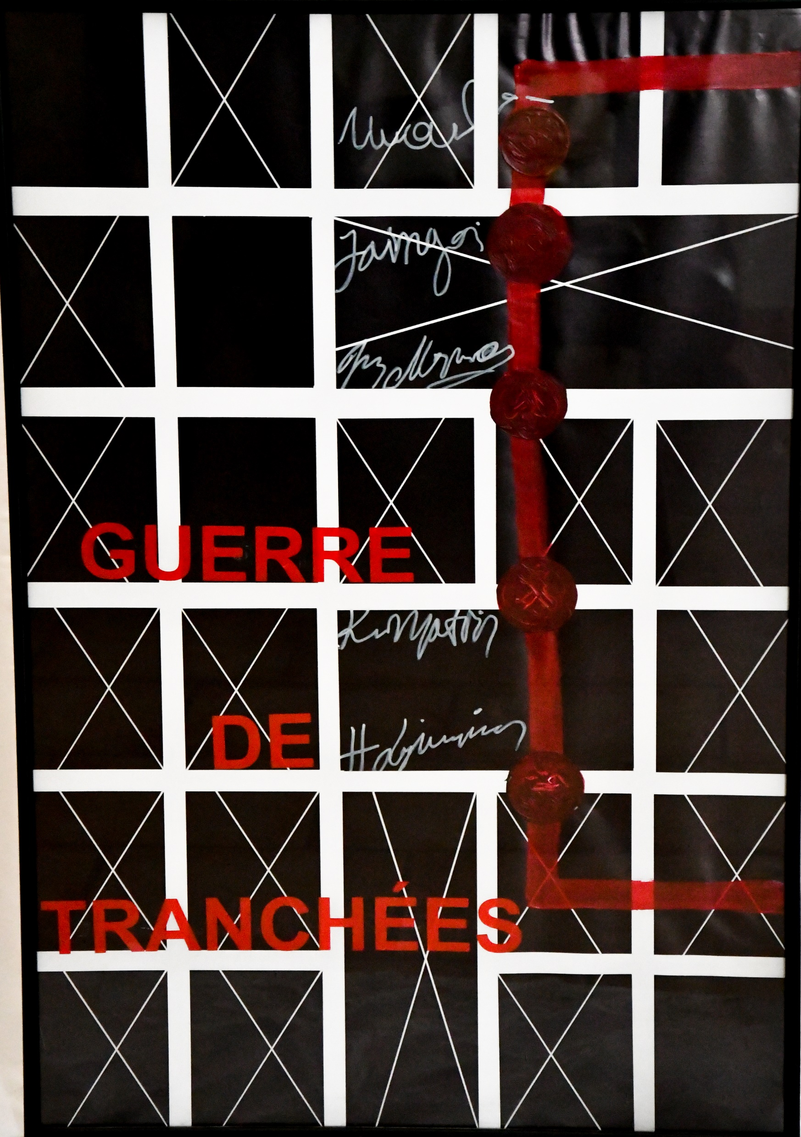
Ljubica Meshkova – Solak (Macedonia)
Carte postal Pour...,
975 mm x 635 mm paper in list

Slide 34
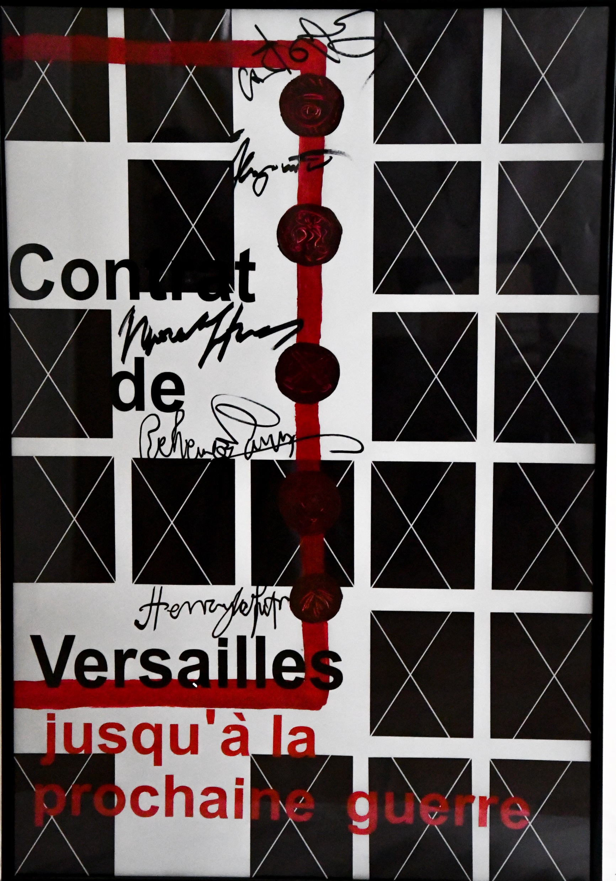
Ljubica Meshkova – Solak (Macedonia)
Carte postal Pour...,
975 mm x 635 mm paper in list

Slide 35
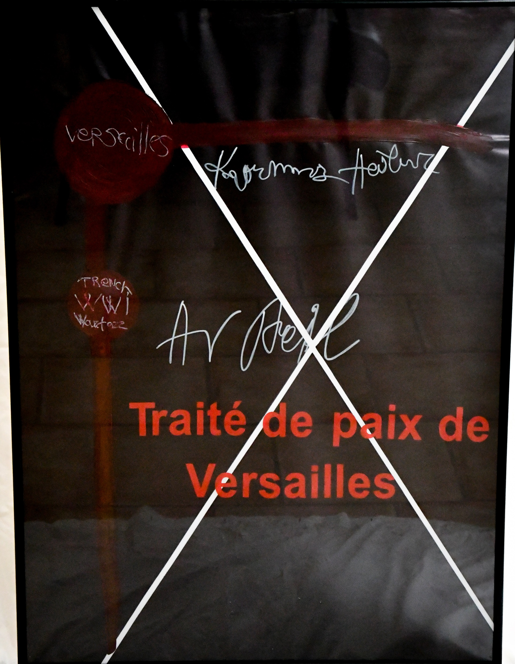
Ljubica Meshkova – Solak (Macedonia)
Carte postal Pour...,
975 mm x 635 mm paper in list

Slide 36
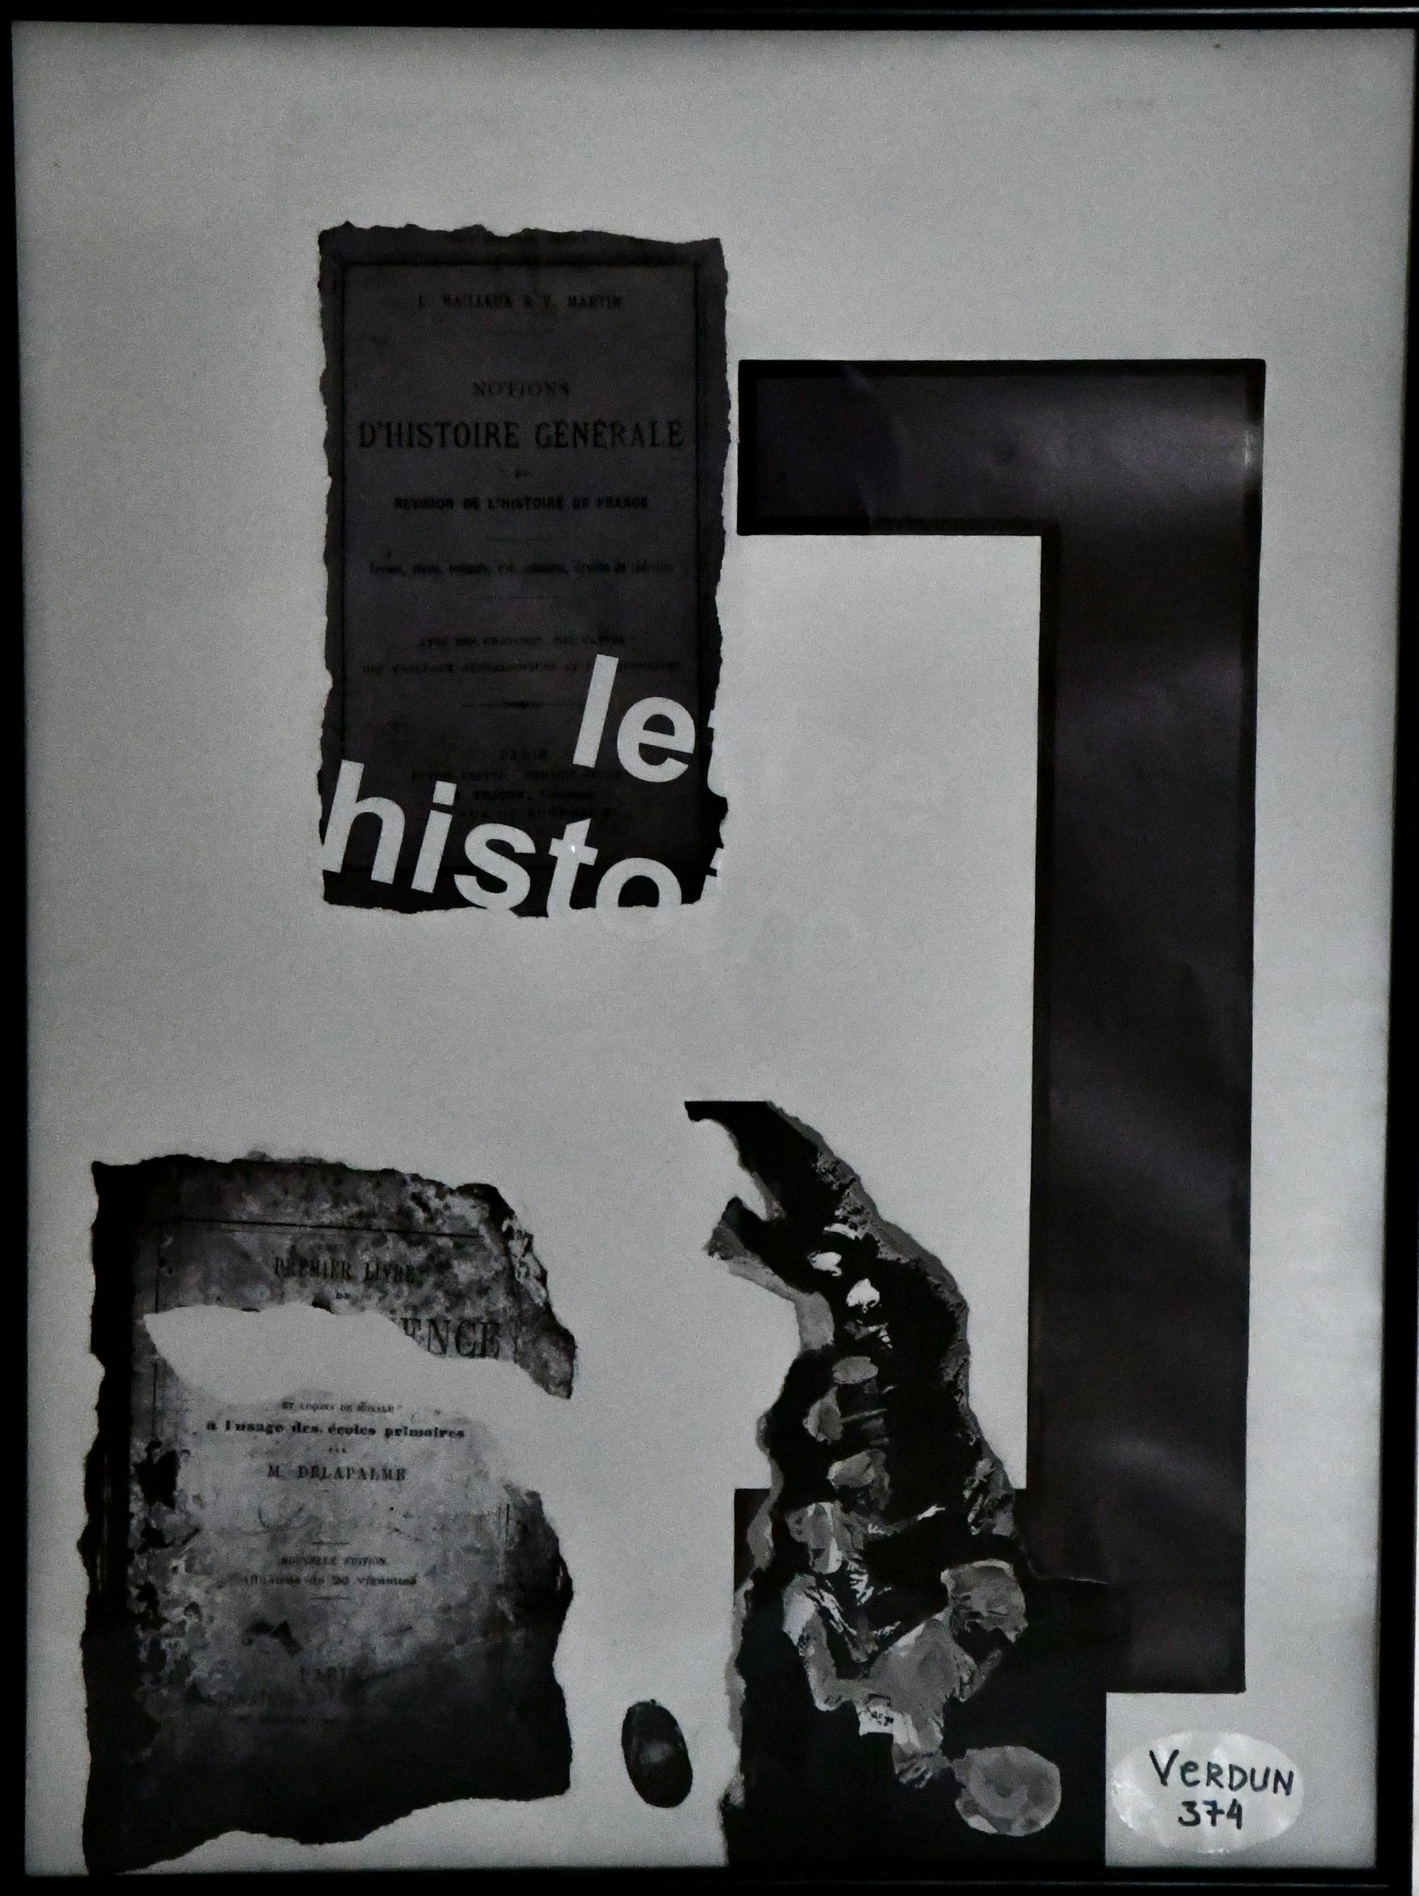
Ljubica Meshkova – Solak (Macedonia)
Carte postal Pour...,
975 mm x 635 mm paper in list

Slide 37
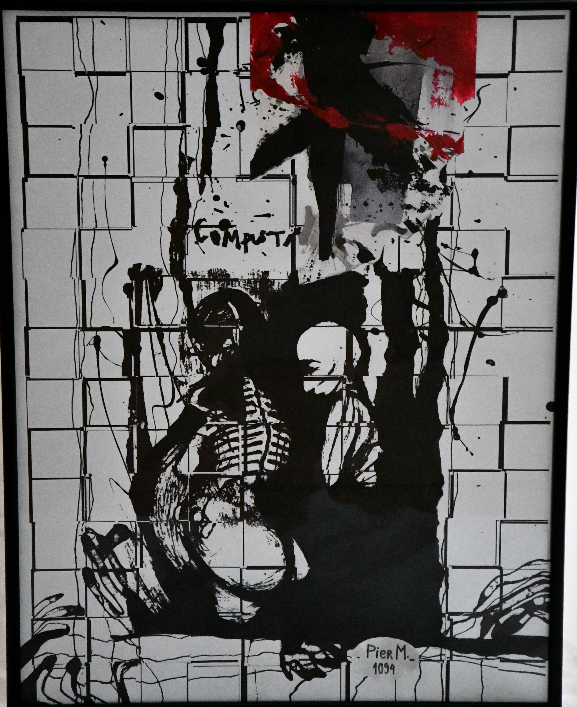
Ljubica Meshkova – Solak (Macedonia)
Carte postal Pour...,
975 mm x 635 mm paper in list

Slide 38
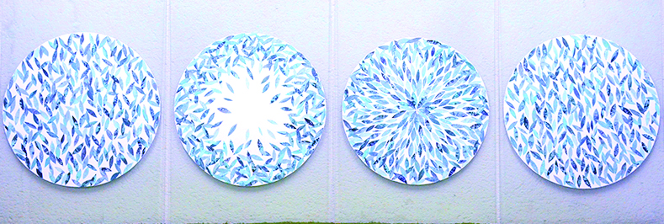
Snezana Petkovic
(Serbia)
"3 seconds memory”,
1000 mm x 700 mm, photographs, archive,collage

Slide 39
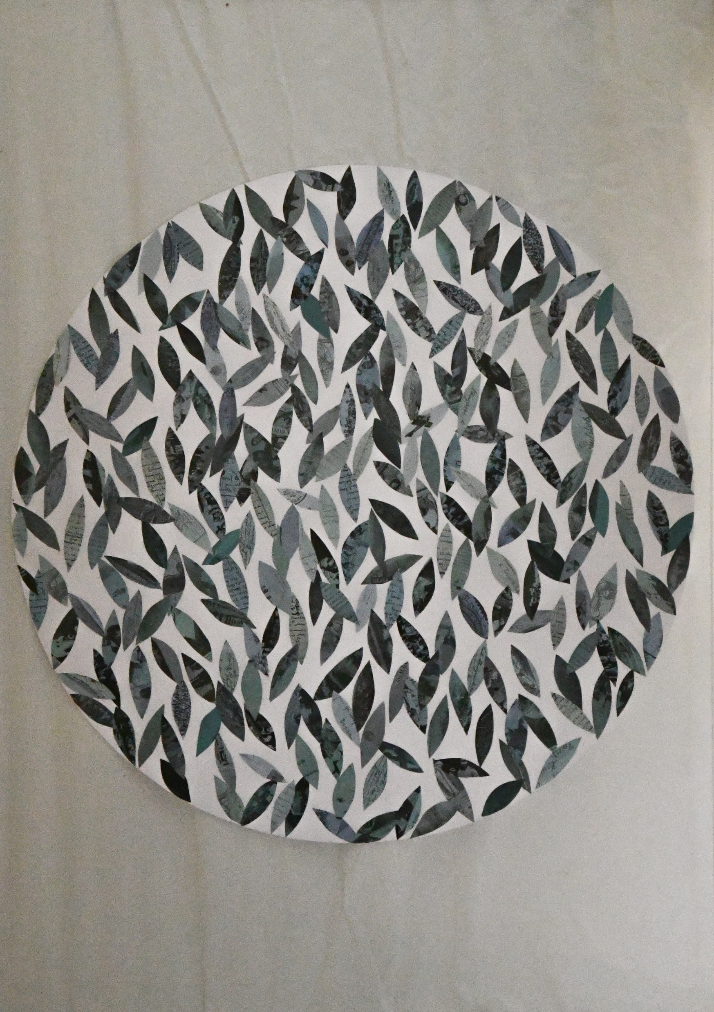
Snezana Petkovic
(Serbia)
"3 seconds memory”,
1000 mm x 700 mm, photographs, archive,collage

Slide 40
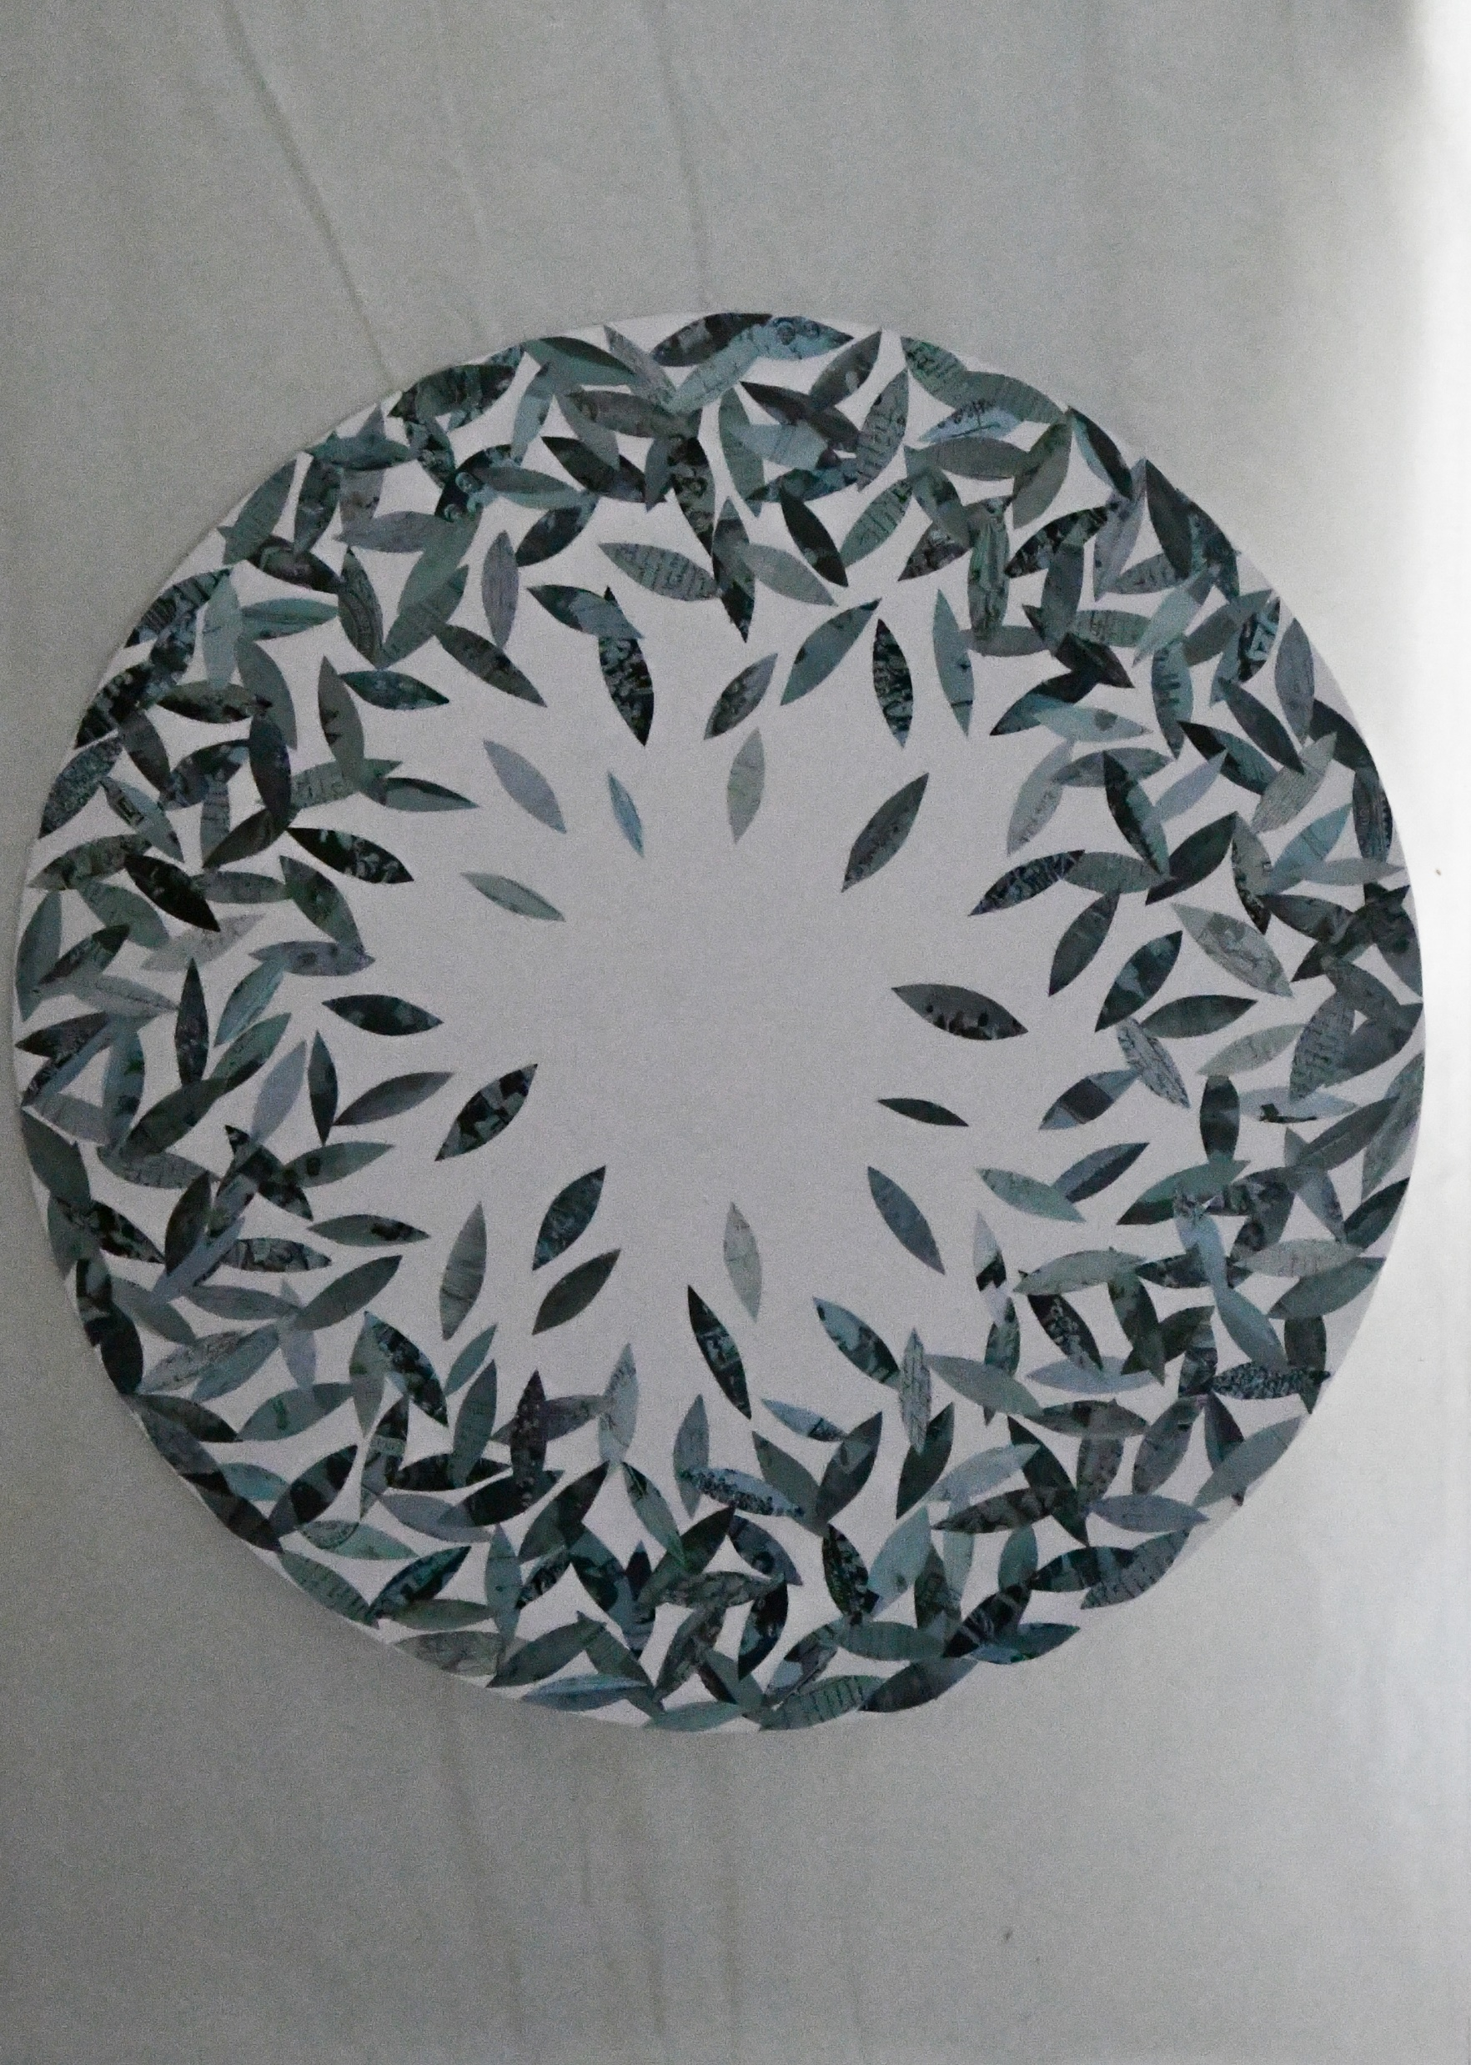
Snezana Petkovic
(Serbia)
"3 seconds memory”,
1000 mm x 700 mm, photographs, archive,collage

Slide 41
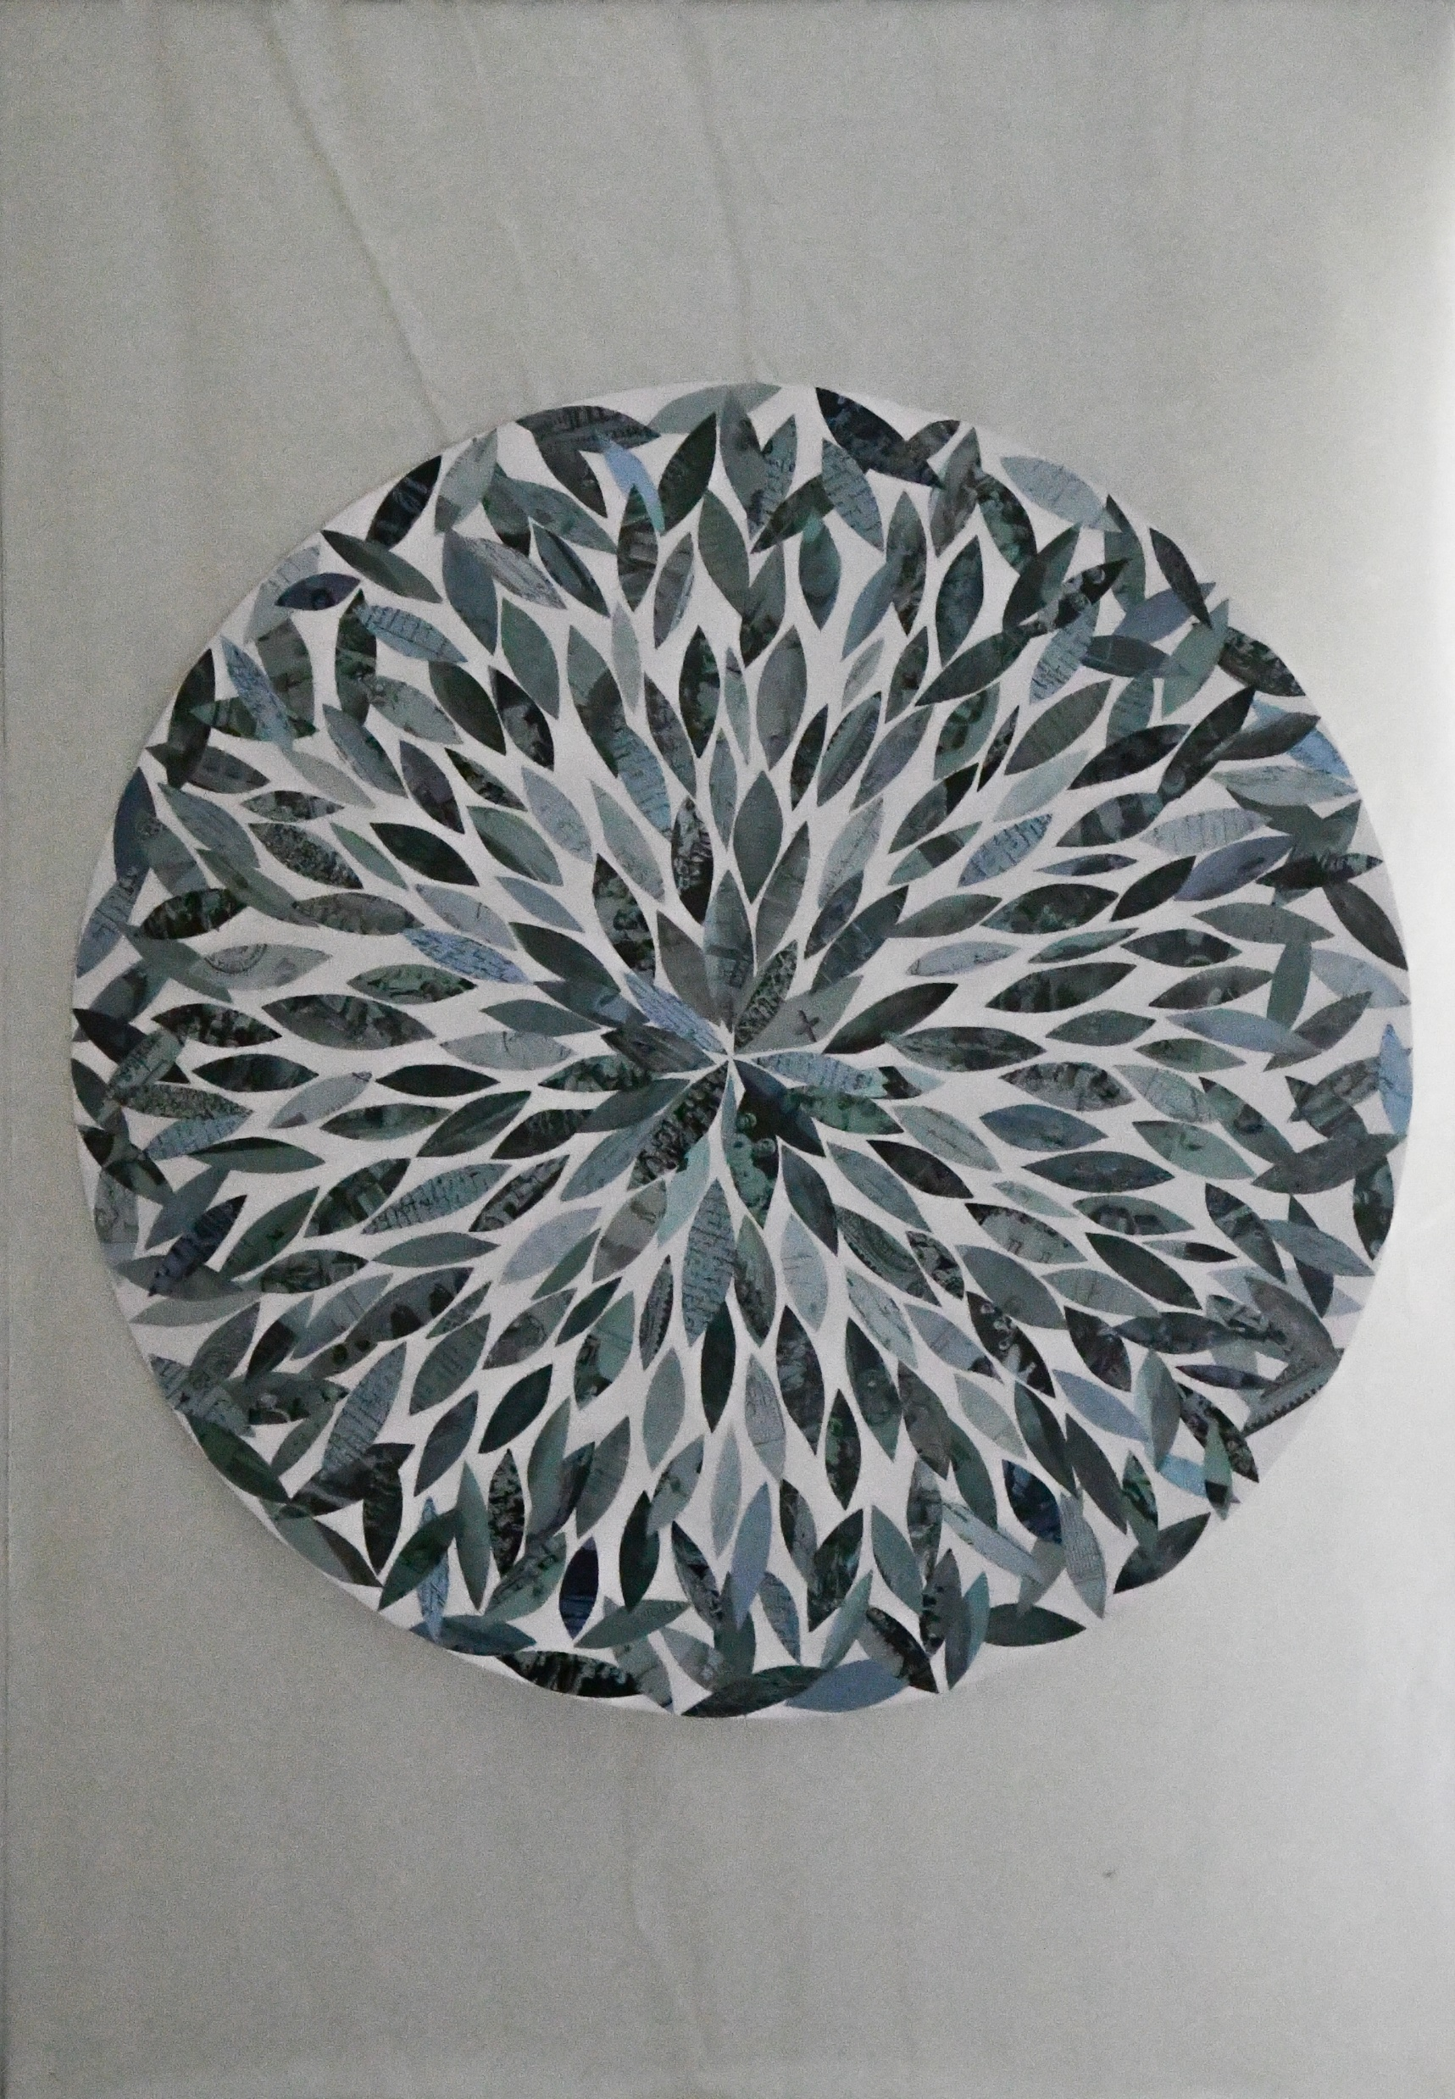
Snezana Petkovic
(Serbia)
"3 seconds memory”,
1000 mm x 700 mm, photographs, archive,collage

Slide 42
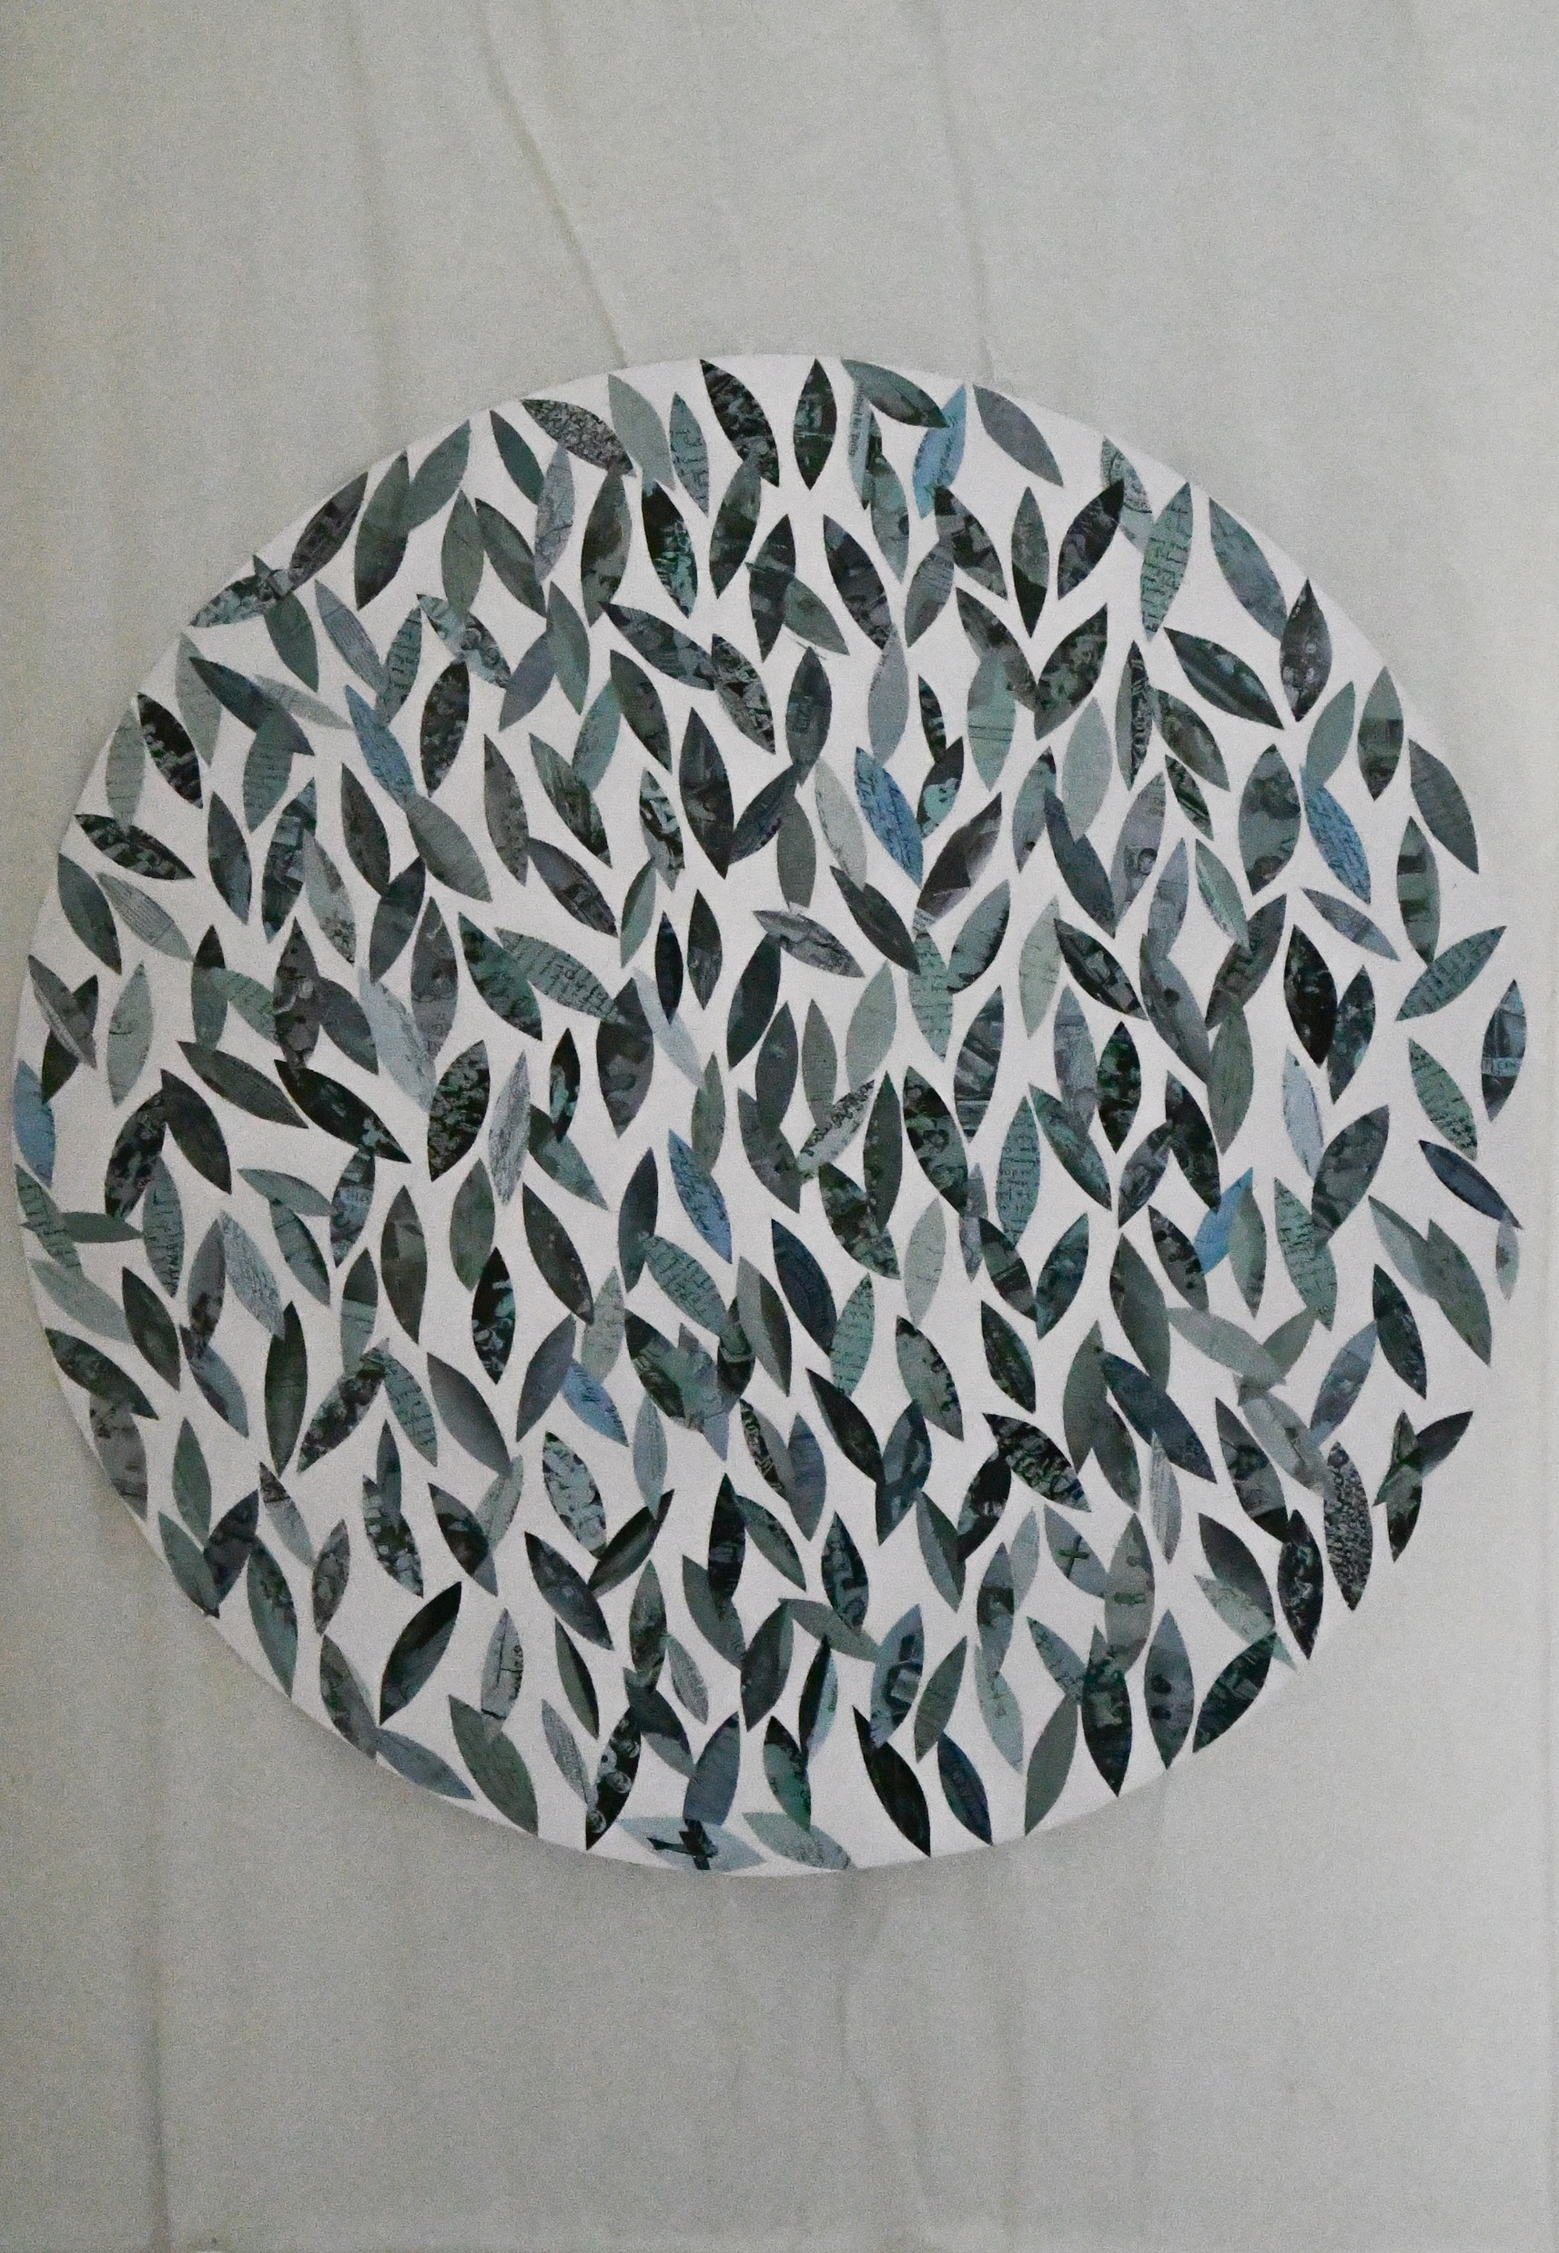
Snezana Petkovic
(Serbia)
"3 seconds memory”,
1000 mm x 700 mm, photographs, archive,collage

Slide 43
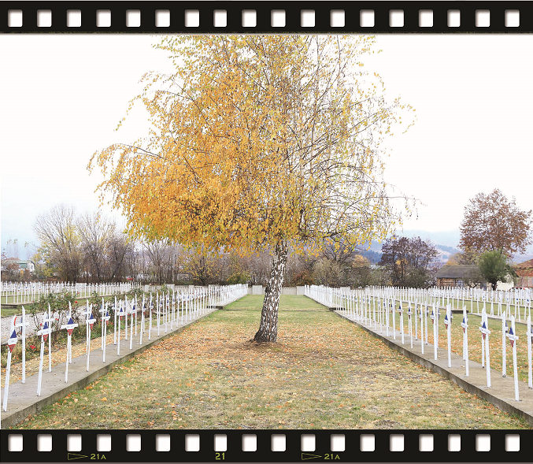
Stratis Vogiatzis & Yorgos Samantas (Greece)
"Dark Heritage”
Documentary film, 24 min
Caravan Project Productions

Slide 44
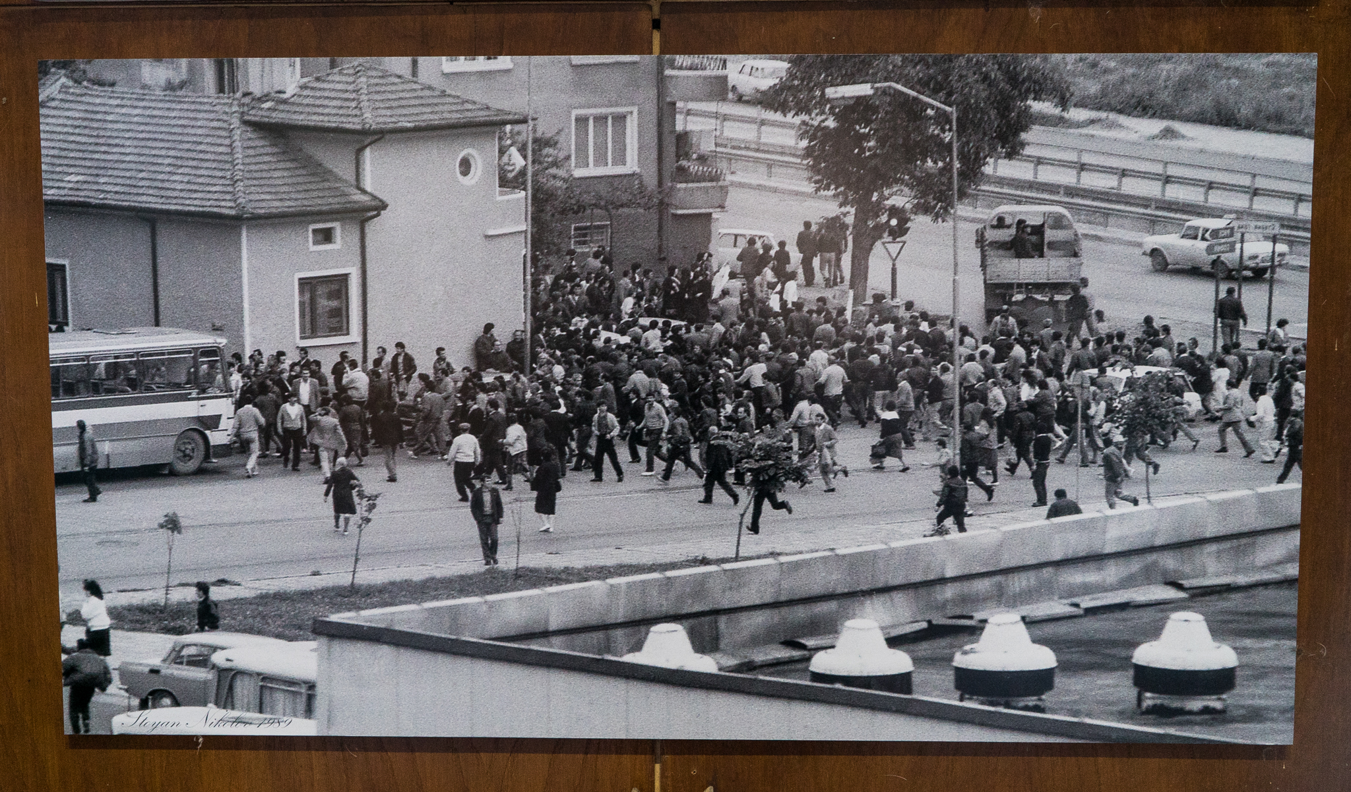
Stoyan nikolov
(bulgaria)
“The Big Excursion” - the exodus of the Bulgarian Turks, photograph

Slide 45
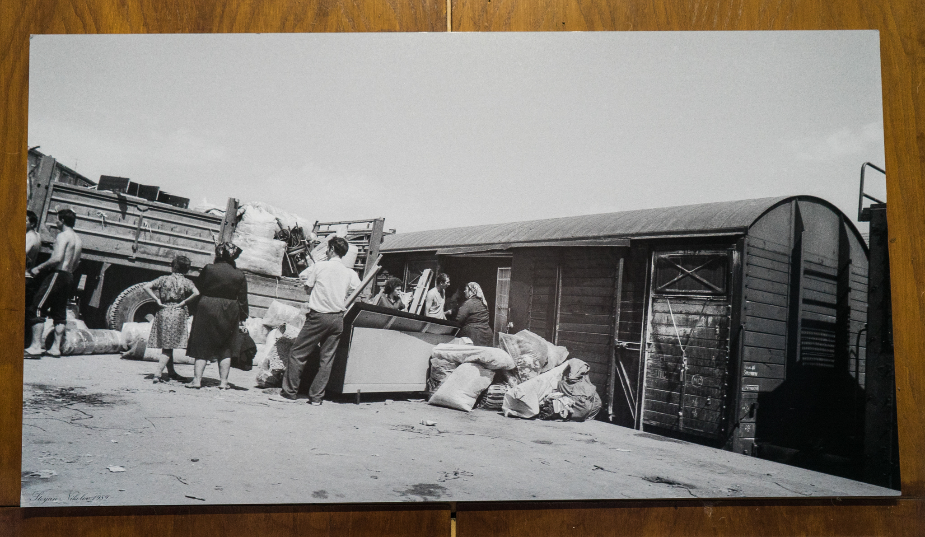
Stoyan nikolov
(bulgaria)
“The Big Excursion” - the exodus of the Bulgarian Turks, photograph

Slide 46
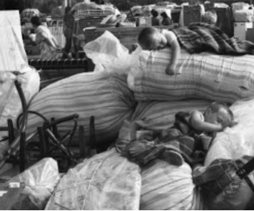
Ivan grigorov
(bulgaria)
“The Big Excursion” - the exodus of the Bulgarian Turks, photograph

Slide 47
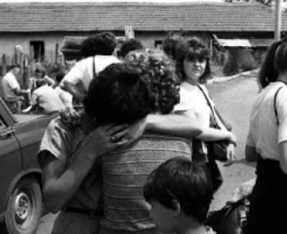
Ivan grigorov
(bulgaria)
“The Big Excursion” - the exodus of the Bulgarian Turks, photograph

Slide 48
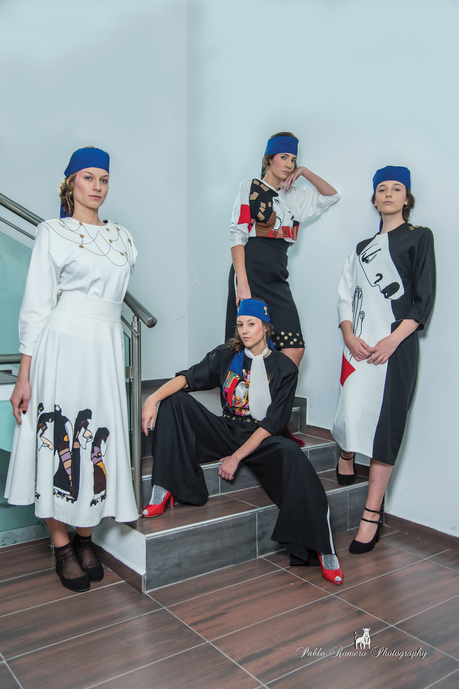
Professional High School of Textile and Fashion Design Varna town
(bulgaria)
Collection inspired from Bulgarian painter Ivan Milev “Our mothers always in black dressed”

Slide 49
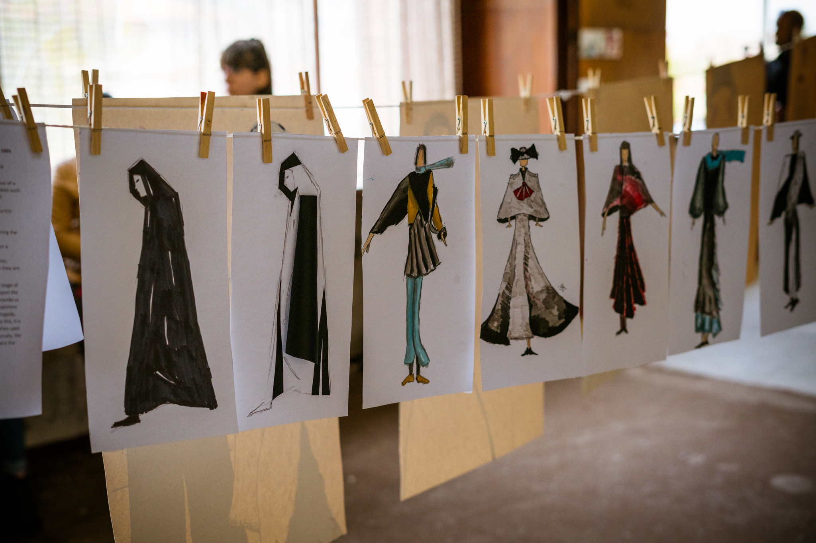
Plener of Bulgarian students
Topic: design of mourning clothes

Slide 50

Plener of Bulgarian students
Topic: design of mourning clothes

Slide 51

Plener of Bulgarian students
Topic: design of mourning clothes

Slide 52

Plener of Bulgarian students
Topic: using the newspapers in the past

Slide 53









European Cultural heritage of stage
OUR HERITAGE,
WHERE OUR PAST MEETS OUR FUTURE
#EuropeForCulture

